Slide 1
Professional Services

Slide 2
Contents
Scenarios
Time & Expense Submission Easy submission of weekly time & expense
Project Finder Discover open projects, activities within your organization
Document Management Easy knowledge management
For each scenario:
Scenario Vision
Primary Persona
Scenario Storyboard
Solution Design Best Practices
Solution Architecture

Slide 3
Time & Expense Submission
Professional Services Book of Dreams

Slide 4


Scenario Vision
Employee
Context
Babak, an employee at Contoso Consulting Services works with multiple clients and juggles various projects both internal and client facing in a typical week
Contoso Consulting’s org policy states that all Consultants must submit the hours logged for each client project and expenses incurred in a weekly manner. Missing Time & expense submission is a compliance issue and needs to be closely monitored
Current State
Babak sets a personal reminder for himself to make sure he doesn’t forget time and expense submission at the end of each week
At the end of week, Babak logs in to the Time & Expense portal on his laptop. He searches for WBS code for his client projects from a different source
As he enters the time spent on each client project, Babak misses an entry and submits.
Babak then opens an expense portal integrated with his credit card statement and files his weekly expense items
Babak’s manager receives notification on his email that Babak has submitted his time & expense report for the week.
Babak’s manager logs in to the portal to view the submitted report. After noticing a missing entry, the manager sends a mail to Babak highlighting the miss
Babak receives the email, acknowledges it and logs in to the portal again to edit the previous entry. With the new edit, he submits the report again
The manager reviews the revised submission and approves it. He does similar process for all of his direct reports in team
Future State
Babak gets a reminder from the Time & Expense Bot at the end of each week prompting him to submit his time report
Babak does not have to login again to the portal. He submits his time information on a pop-up window within Teams
The app also provides list of his recent corporate credit card expenses for Babak to submit.
On submission, Babak’s manager receives a notification on his Teams app with a consolidated view of time submission from his direct reports
The manager is able to view details of time & expense submissions of each of his direct reports and accept / reject submissions. Manager rejects Babak’s submission highlighting a missing entry
On receiving notification of Manager’s rejection of time report submission, Babak can edit the report within Teams app and re-submit
The manager gets a single view of all time & expense submissions from his direct reports and can take actions on these submissions in one place
- Points of Friction

Slide 5

Babak Shammas, Consultant
Babak is a consultant at Contoso Consulting Services. Babak works with clients in different industries. He typically spends his time multi tasking 2 – 3 projects during a week and also splits his time on internal projects for Contoso.

Slide 6
It’s end of week and time for Babak to submit time report capturing the time he spent on various projects along with the expenses he incurred during his travel, meals for each client

Slide 7
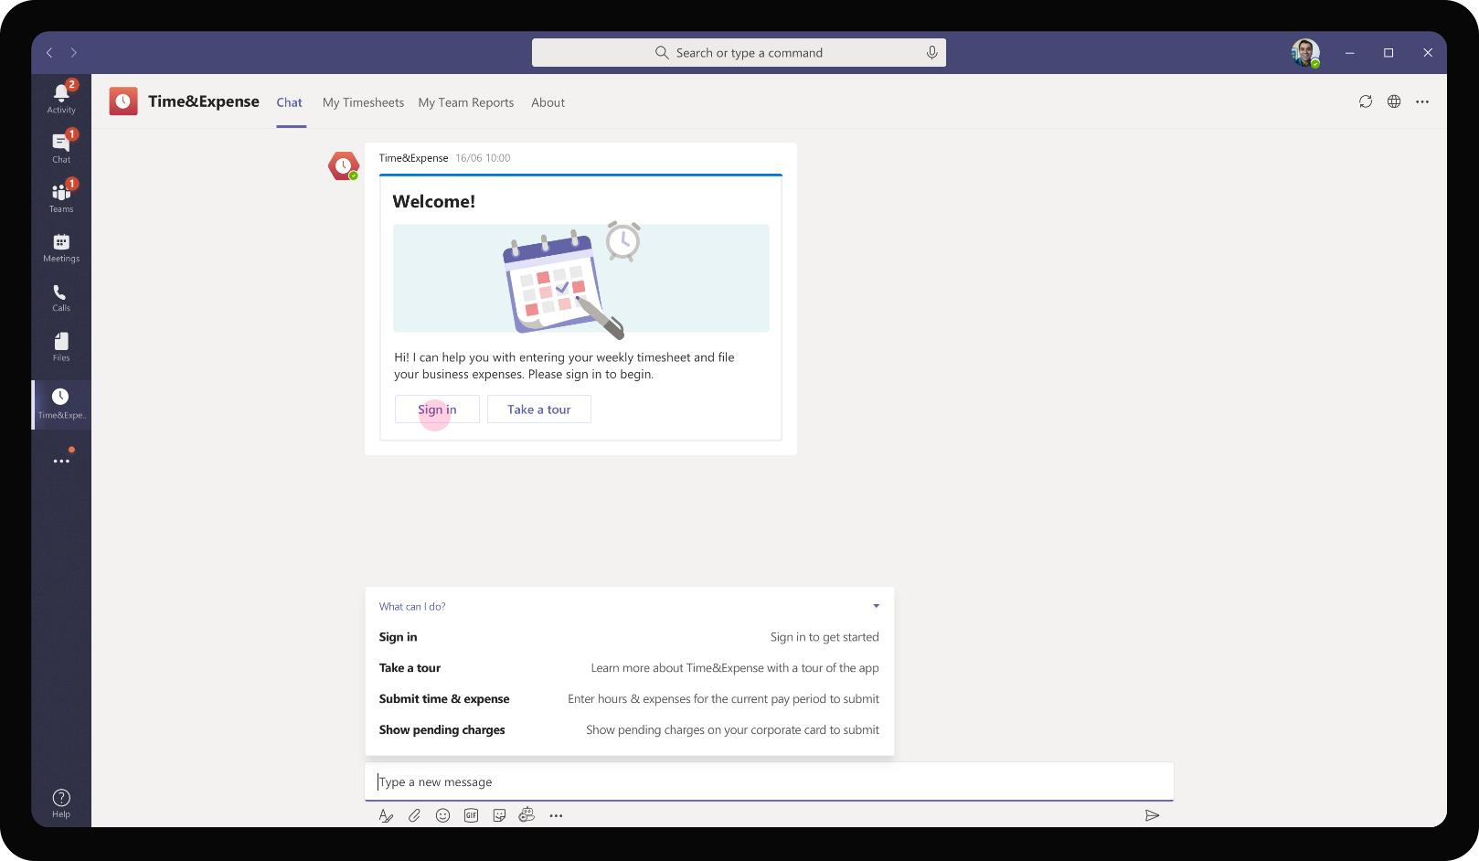

Professional Services – Time & Expense
Babak accesses the Time & Expense app on his personal scope and performs a sign-in the first time he accesses the app. The sign-in enables the app to securely authorize Babak to access his expense reports and to submit expenses for the audit team to approve

Slide 8
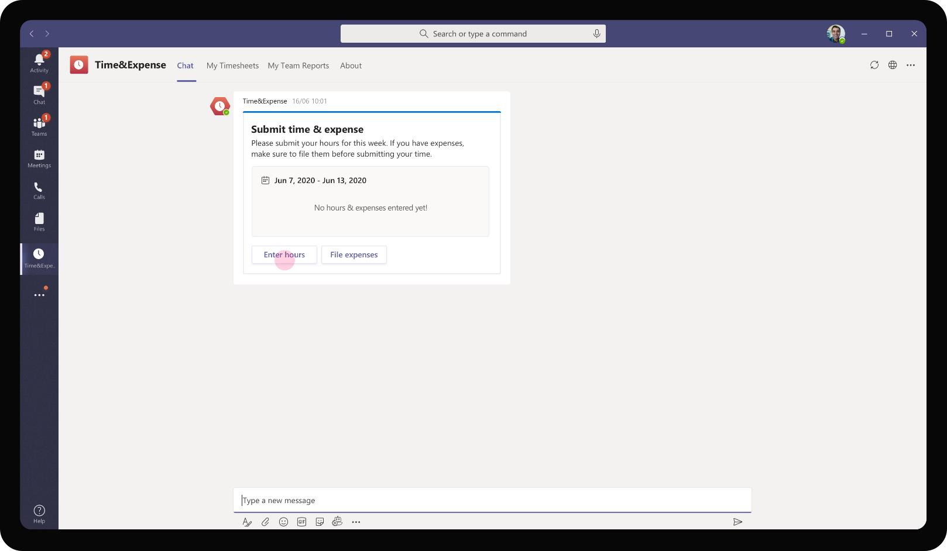
Professional Services – Time & Expense
On logging in, the app sends an adaptive card to Babak prompting him to log his time spent over the past week. It has a separate entry point for filing expenses as well.

Slide 9
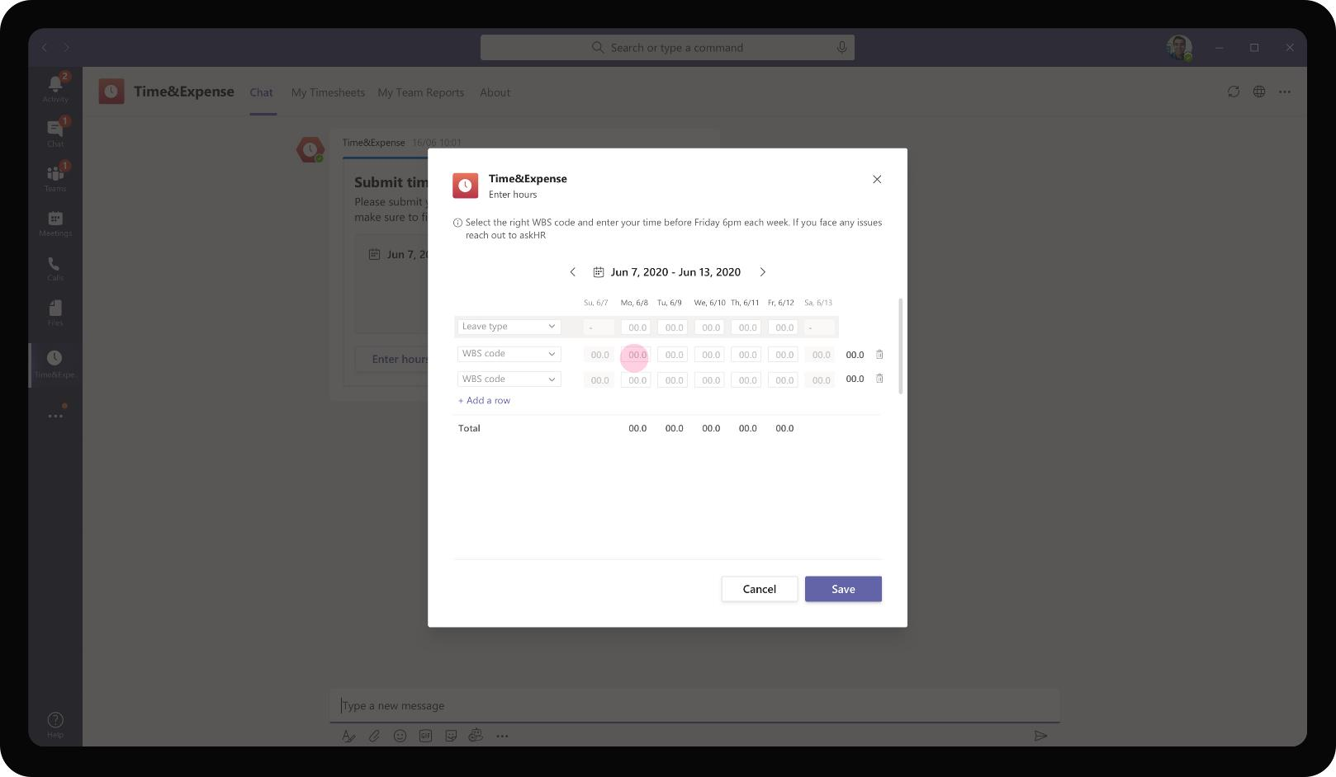
Professional Services – Time & Expense
On clicking on Enter hours, the app prompts a task module with input fields for Babak to enter the WBS code for each project he has worked on. Babak will be able to cycle through previous week’s time sheets as well using this task module.

Slide 10
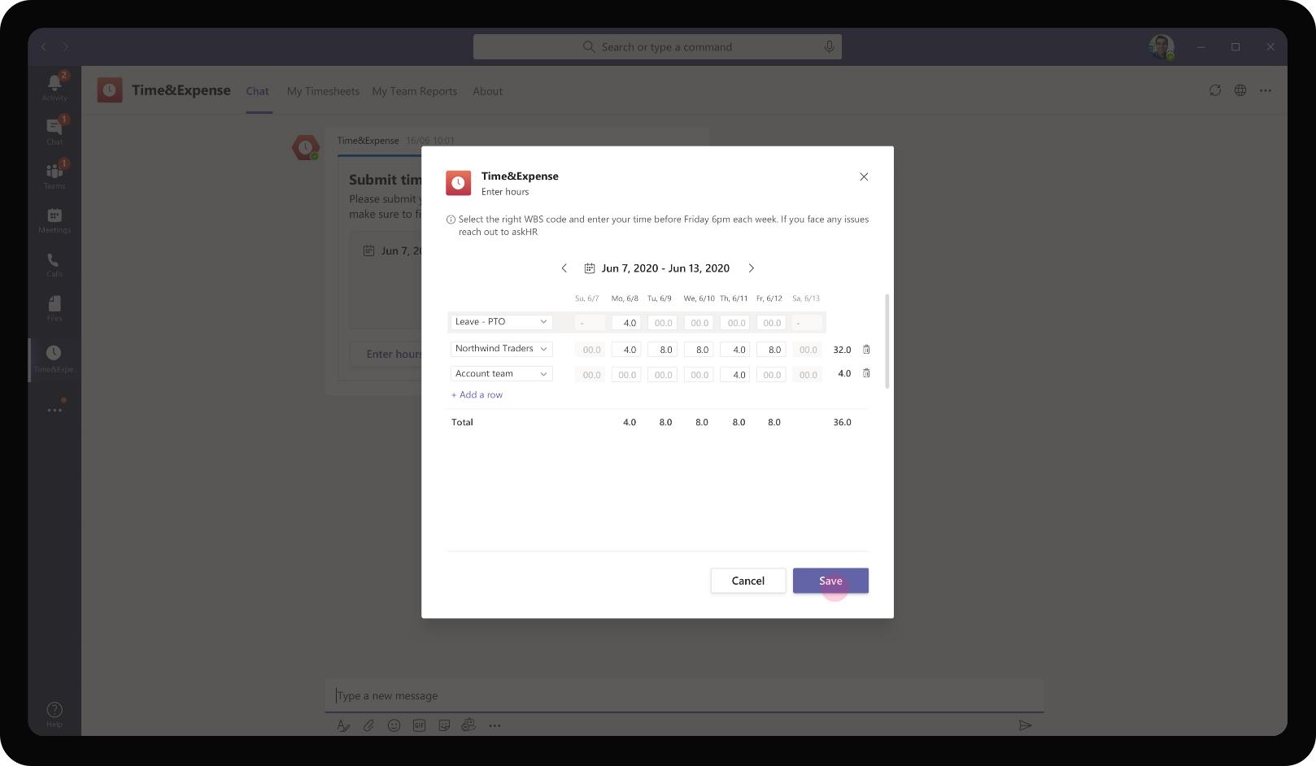
Professional Services – Time & Expense
Babak proceeds to enter the hours he has logged over the week in the task module. He is able to select the right project from the WBS code as the app integrates with the LOB project information database.

Slide 11
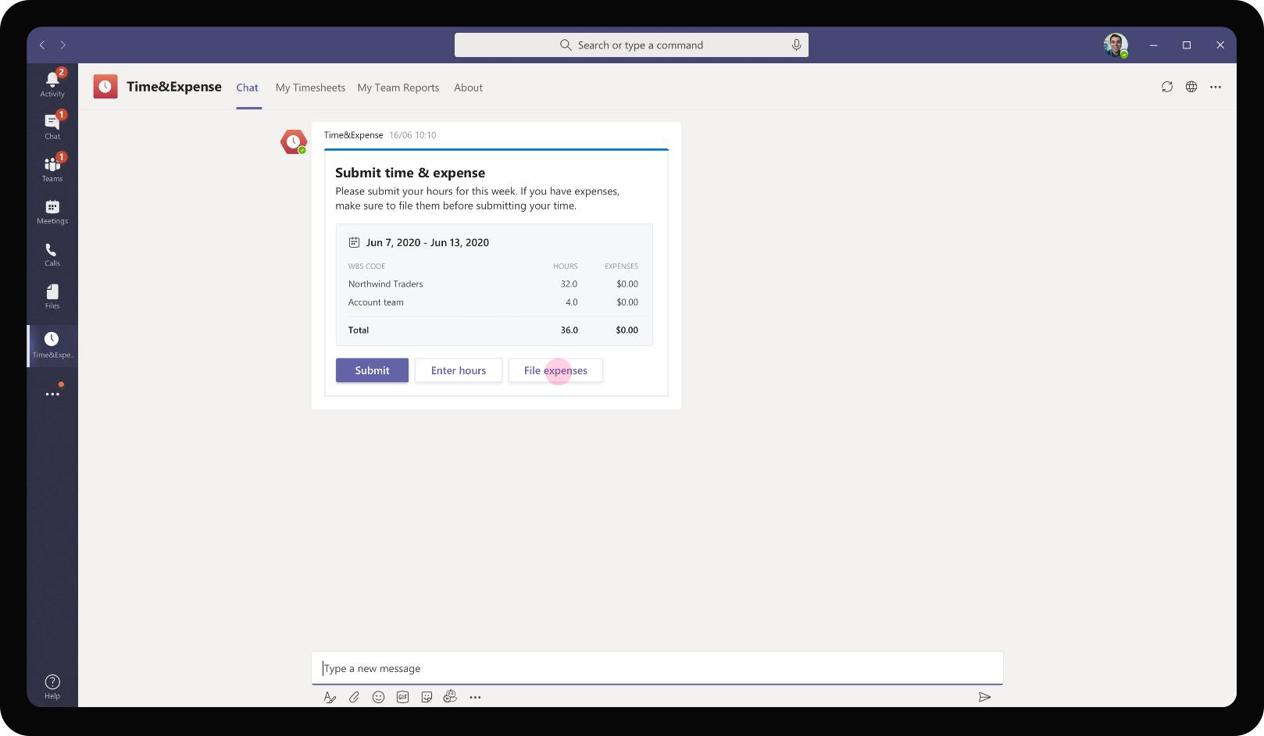
Professional Services – Time & Expense
On entering the hours and saving it, the hours are saved in a Time & Expense report that is ready for Babak to submit. At this point, Babak can choose to file expenses he has incurred over the past week before submitting the report.

Slide 12
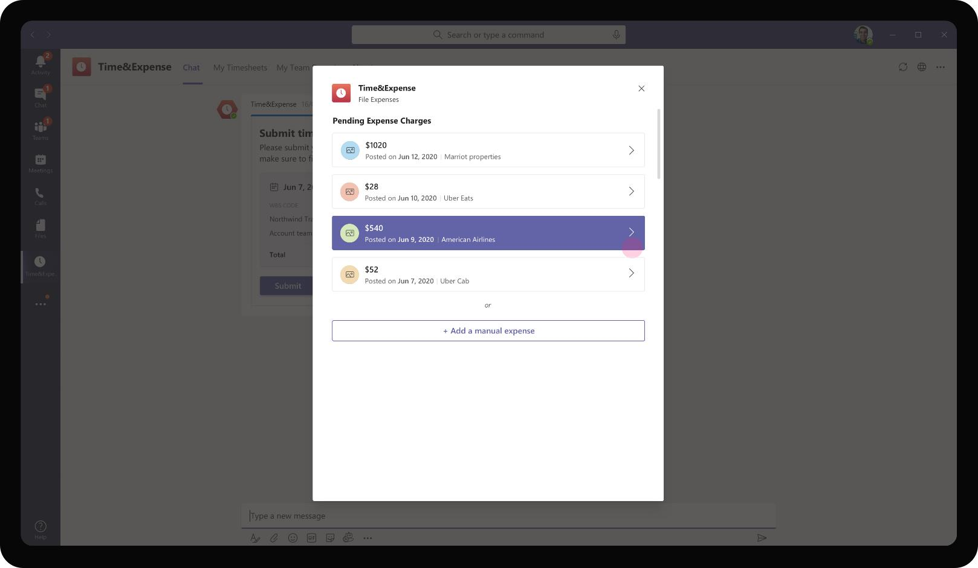
Professional Services – Time & Expense
On clicking File Expenses, the app prompts another task module that pulls in the expenses charged on his corporate card from back end system. Babak can directly file those expenses or choose to enter a manual expenses he might have incurred while using cash or non-corporate card.

Slide 13
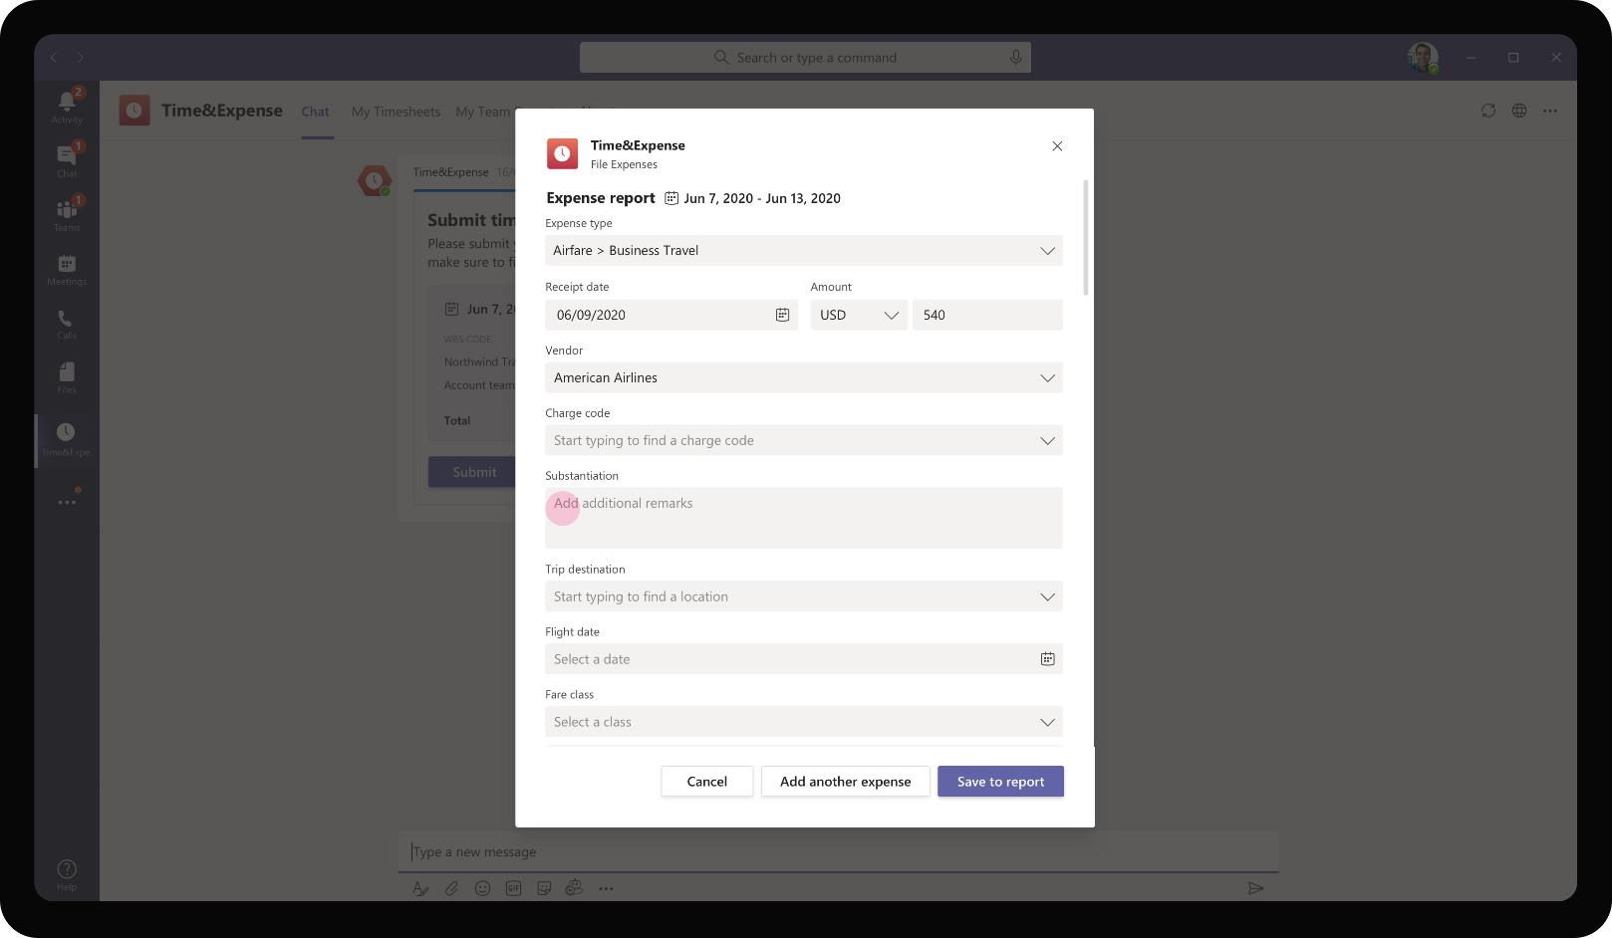
Professional Services – Time & Expense
As Babak proceeds to file an airline expense, the task module opens up a customized set of input fields specific to the expense type ‘Business Traven -> Airfare’. This page is customized and differs based on the expense type to be submitted.

Slide 14
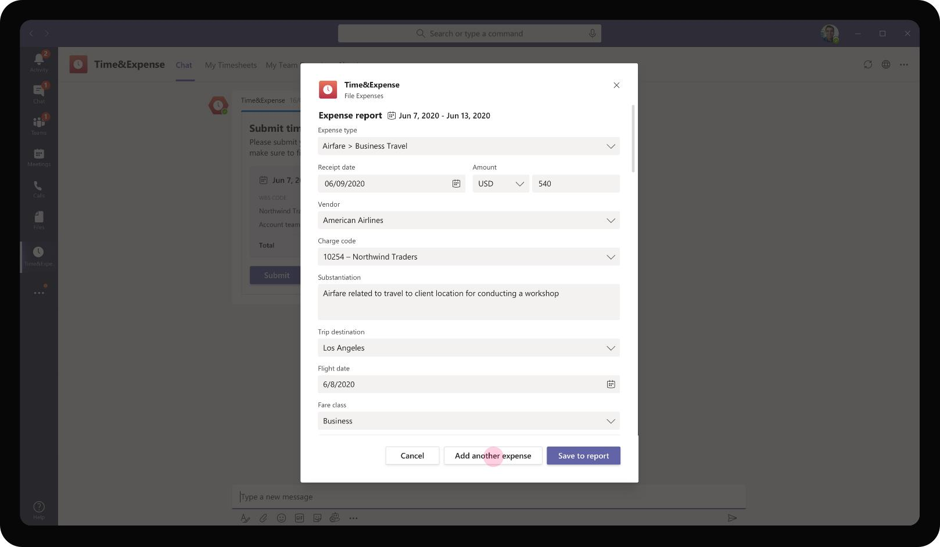
Professional Services – Time & Expense
Babak enters the details around the expense and the business justification for the same. After charging it to the right client account, he chooses to add another expense or end the process by choosing Save to Report.

Slide 15
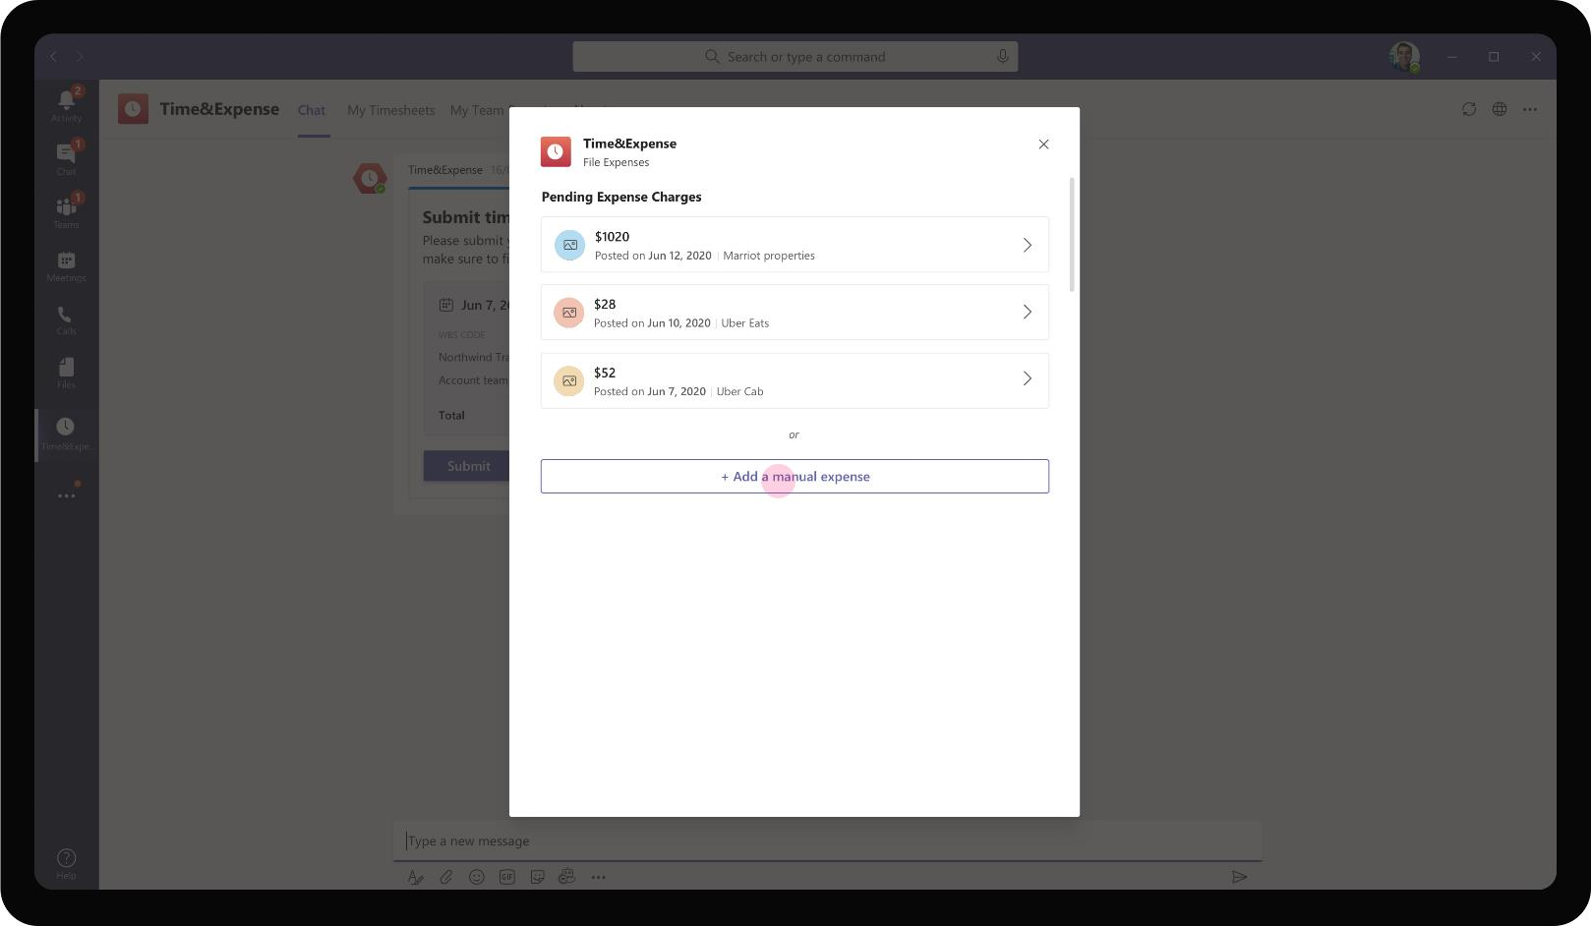
Professional Services – Time & Expense
As Babak chooses ‘Add another expense’, the task module brings Babak back to the initial page where he has the option to file a pending charge or a new manual expense. The Air travel expense is not available anymore as Babak has acted on it.

Slide 16
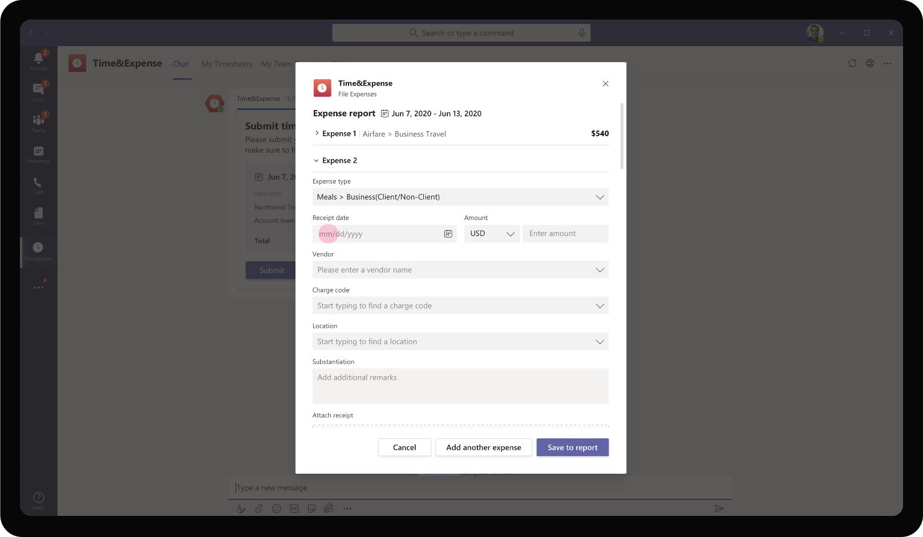
Professional Services – Time & Expense
As Babak chooses to enter a manual expense, the app does not assume the input fields and waits till Babak chooses the ‘Expense type’. Based on the expense type, the rest of input fields appear for Babak to fill and submit.

Slide 17
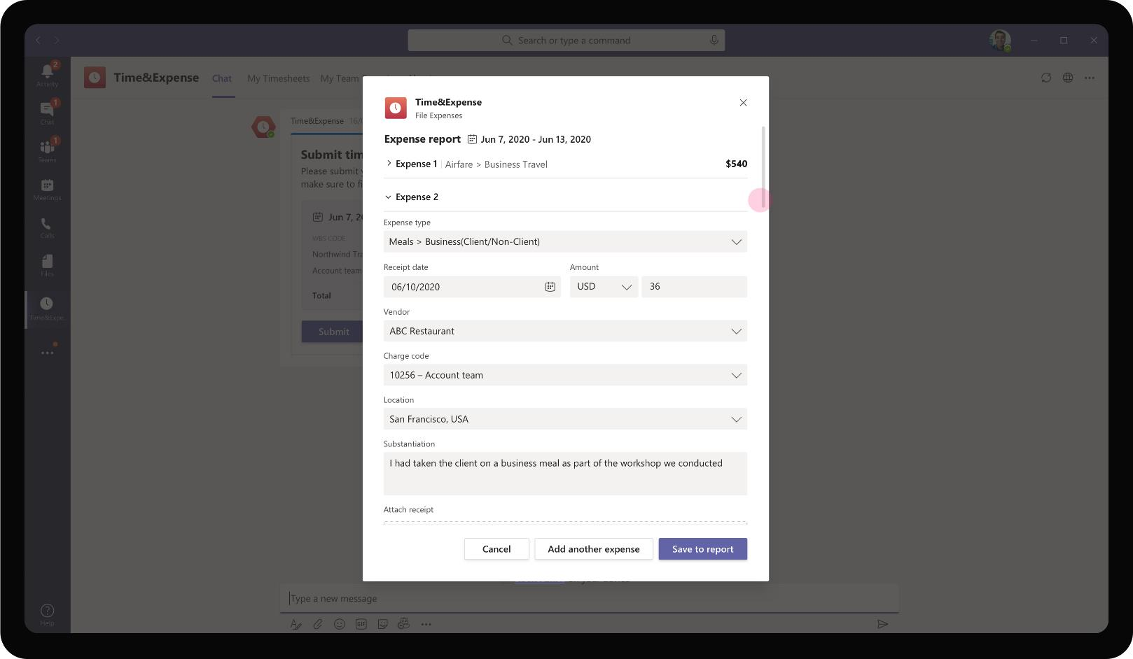
Professional Services – Time & Expense
Babak proceeds to file the meals expense he incurred at a restaurant and charges it to specific WBS code. App also provides ability to add expenses in different currencies.

Slide 18
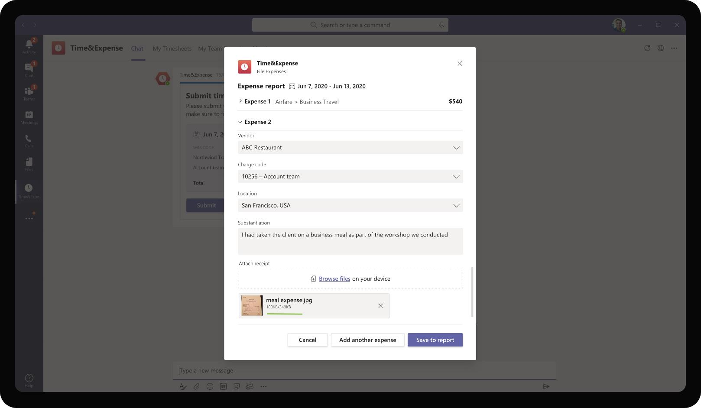
Professional Services – Time & Expense
Inherent to any expense submission process, the app has a provision to submit expense receipts as proof of incurred expense. Babak will be able to add any image from his phone gallery as an attachment along with each expense item.

Slide 19

Professional Services – Time & Expense
Post entering all expense details and uploading relevant receipts for each expense item, Babak saves the expenses filed to the report.

Slide 20
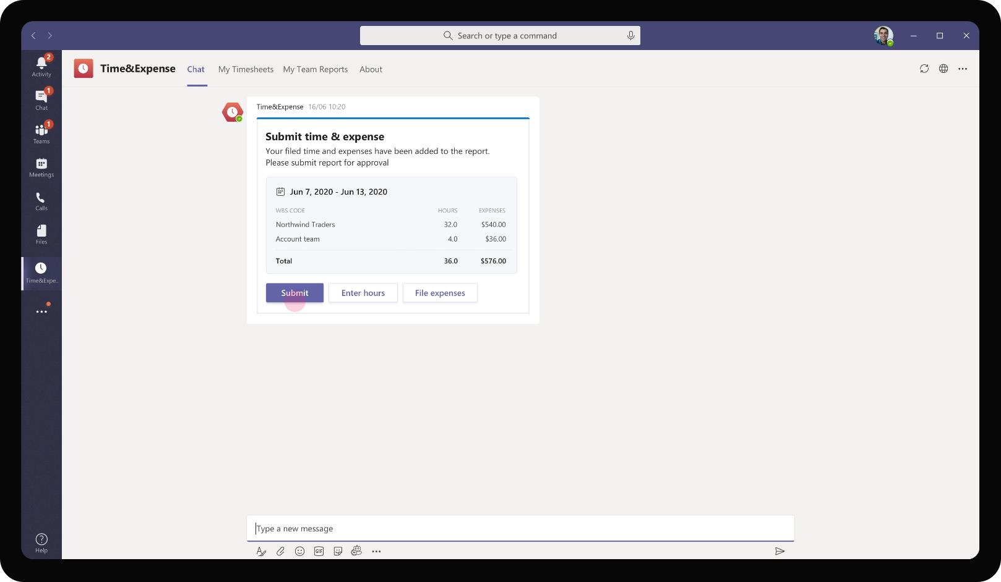
Professional Services – Time & Expense
As Babak saves the expenses as well to the report, the same adaptive card refreshes to show updated expenses for each project as a line item. After validating once, Babak can submit the report for approval

Slide 21
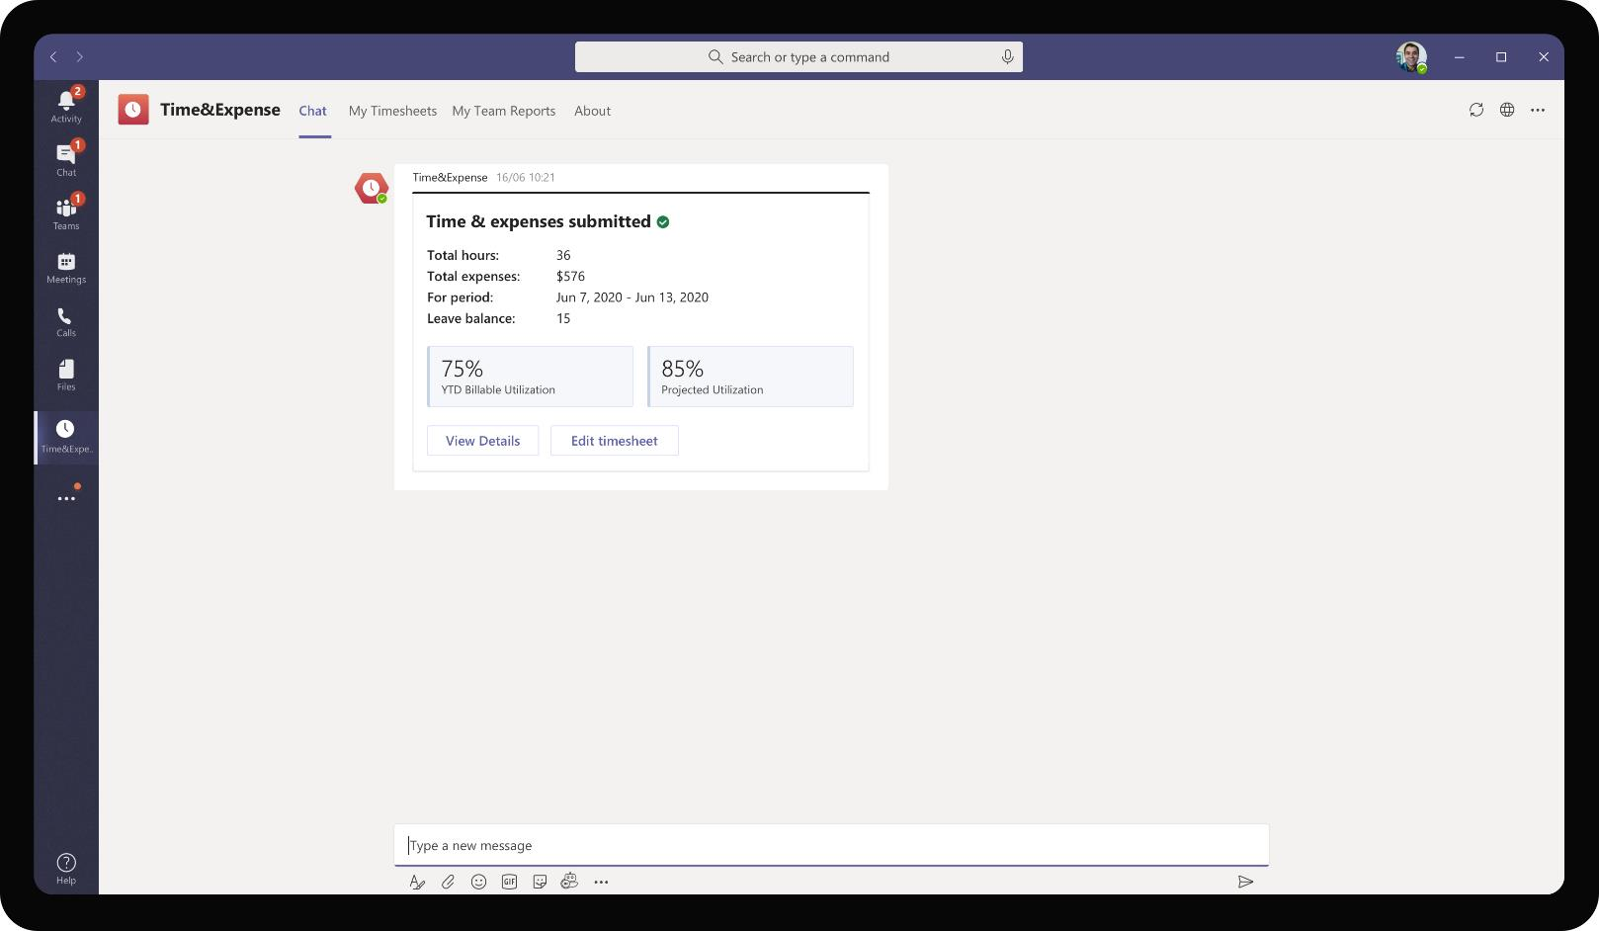
Professional Services – Time & Expense
The adaptive card refreshes to show that expenses have been submitted with a view of submitted total hours and expenses. In addition, it shows Babak’s time utilization metric until the current week and project utilization for the financial year with the current trend.

Slide 22
When the due date for filing expenses incurred are nearing and Babak has not filed expenses yet, the app proactively reminds Babak to file expenses incurred on his corporate card

Slide 23
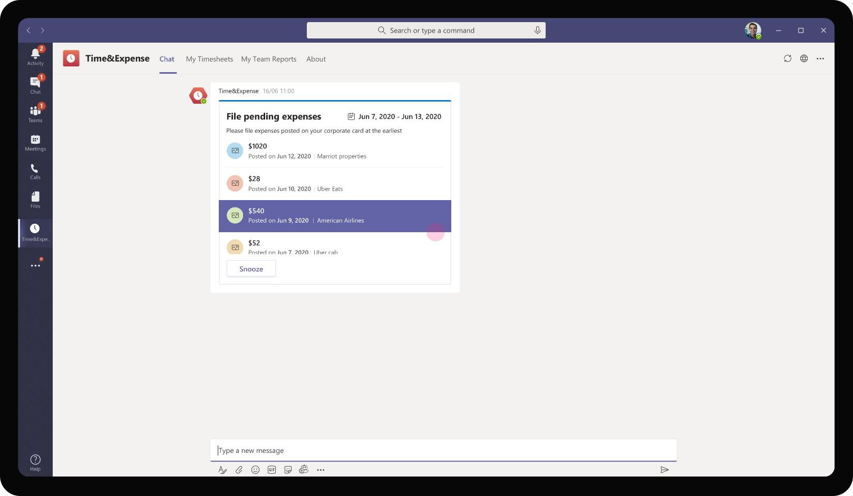
Professional Services – Time & Expense
The app sends a proactive messages to Babak’s personal chat with a list of expense items incurred on Babak’s corporate card. Babak can add these expenses to the week’s report directly from this list for submission

Slide 24
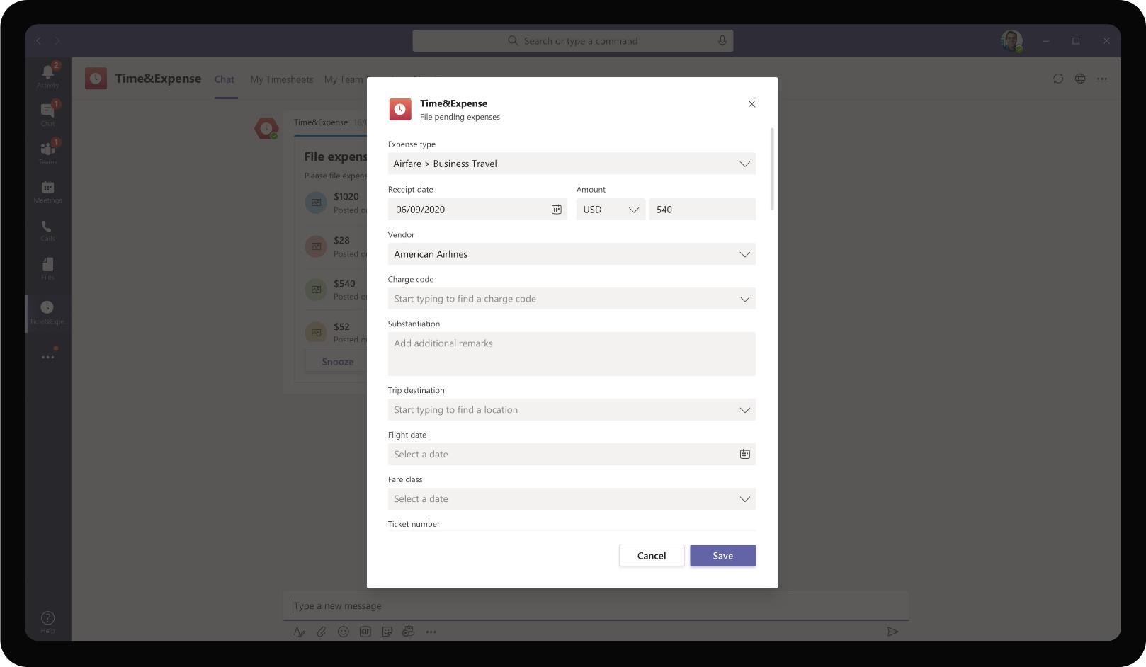
Professional Services – Time & Expense
On clicking an item on the expense list, a task module opens with fields pre-filled for the selected expense item. Babak is prompted to enter other fields manually before submission.

Slide 25
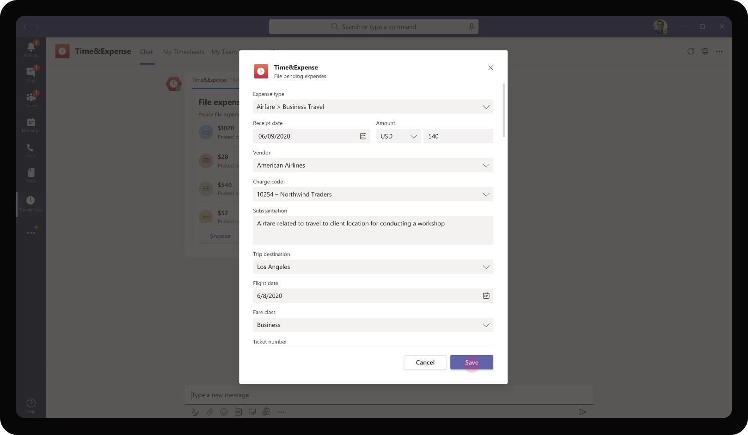
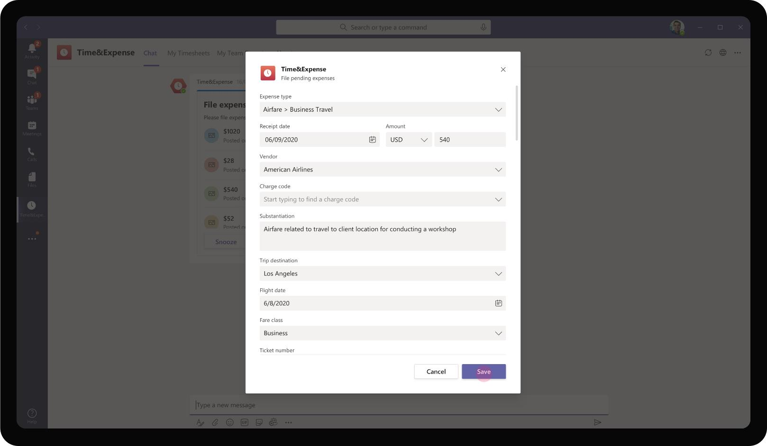
Professional Services – Time & Expense
Babak proceeds to enter details of his ‘Airfare’ expense. After he completes entering the details and uploading relevant receipts, he can save the expense item to the report for submission.

Slide 26
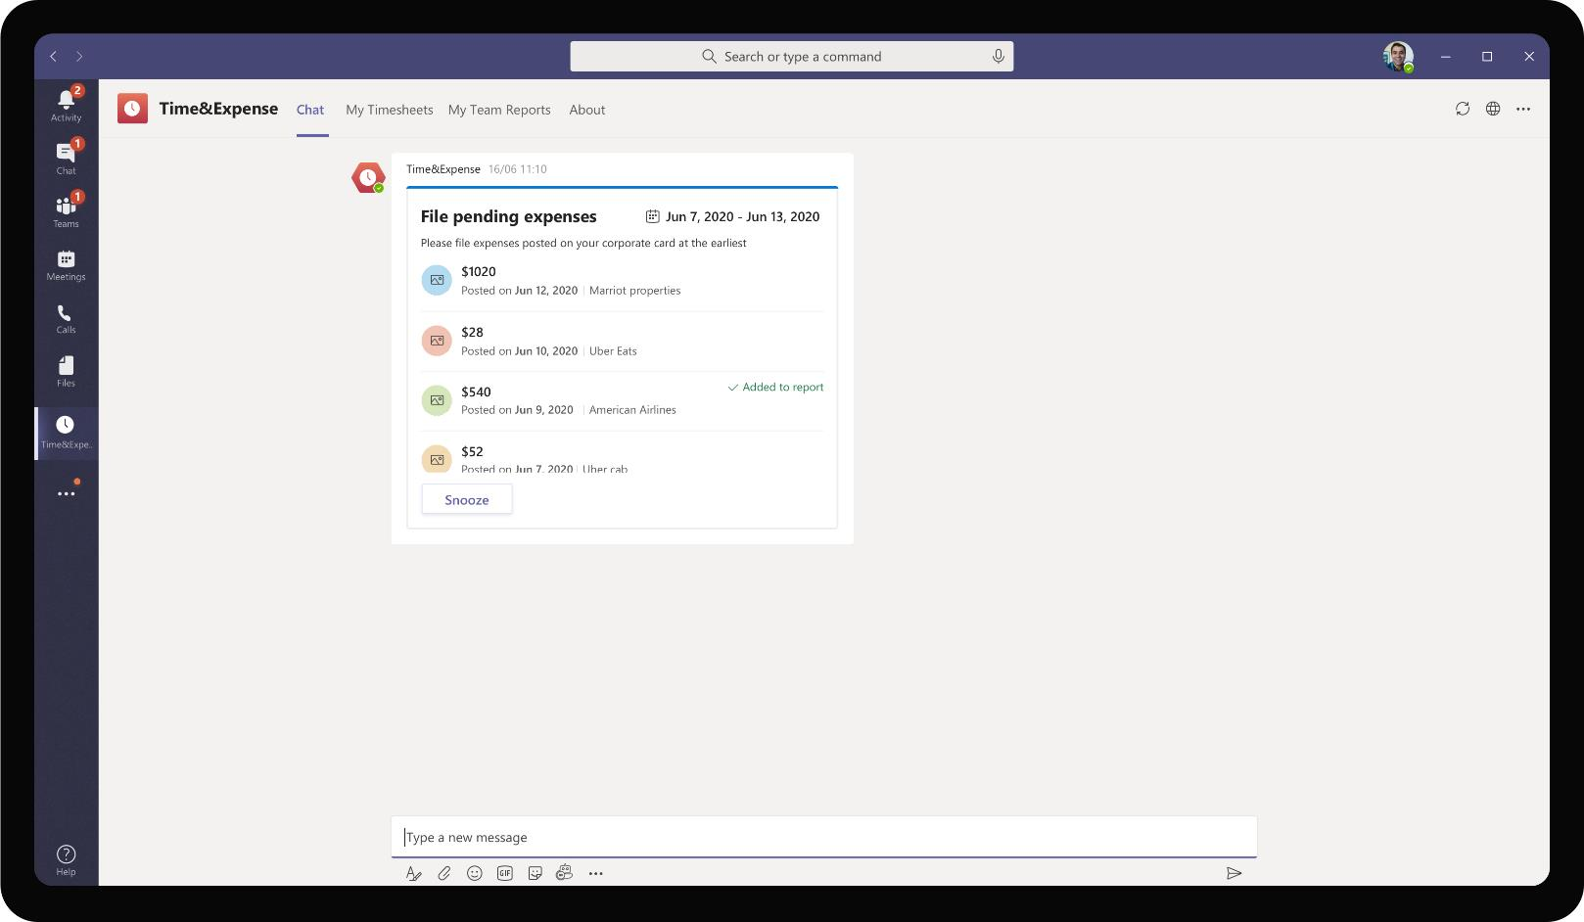
Professional Services – Time & Expense
On clicking save, the adaptive card refreshes to show the expense item which was just saved and added to the report. Babak proceeds to enter details around other expense items in the list.

Slide 27

Professional Services – Time & Expense
After all expenses are added to the report, Babak is ready to submit the report by end of week or by manually invoking the Submit time & expense bot command.

Slide 28
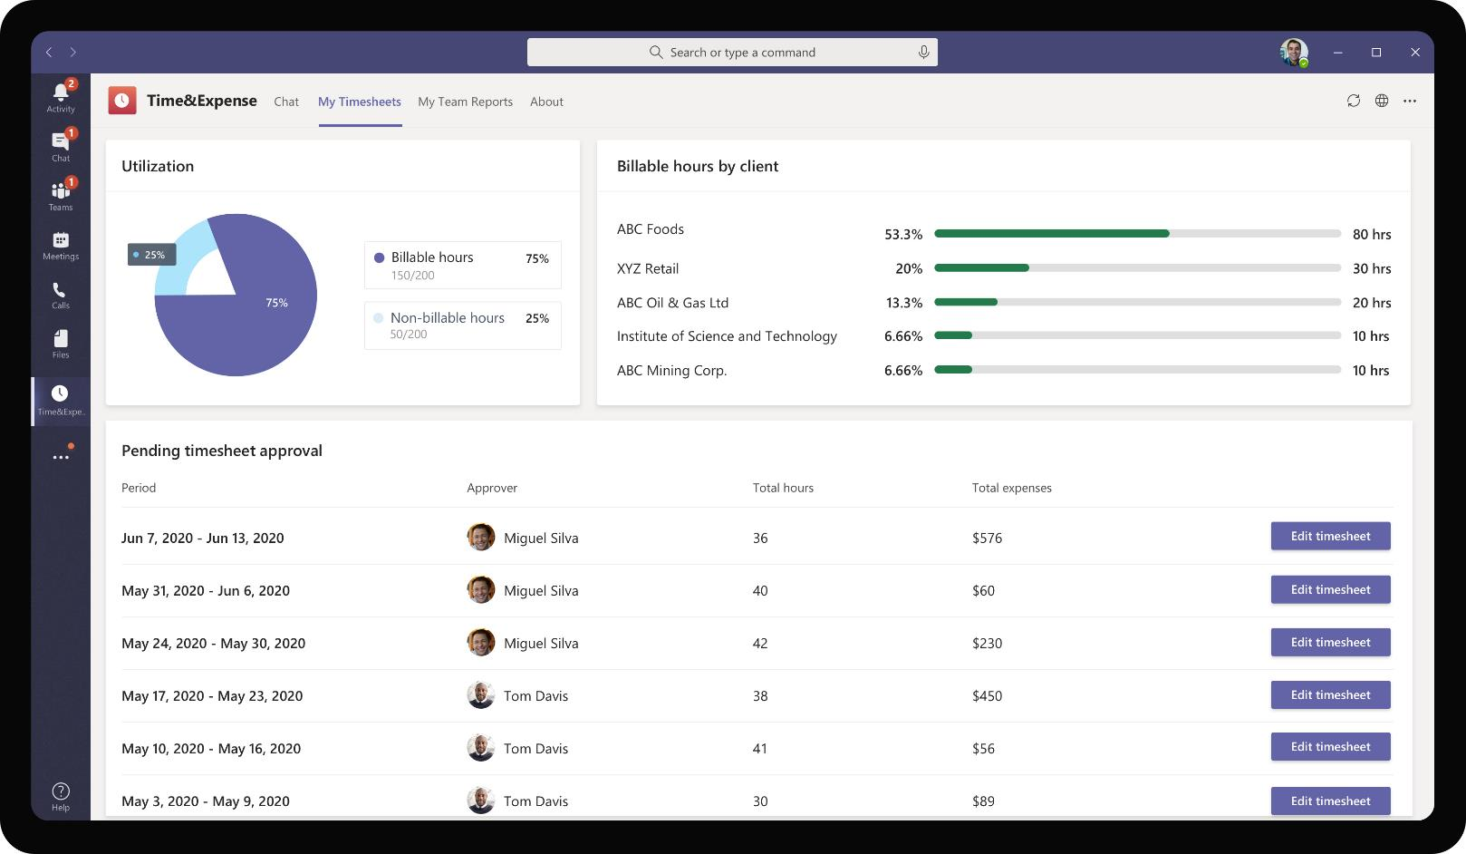
Professional Services – Time & Expense
In addition to allowing submission of time & expenses, the app provides a real time view of Babak’s Utilization, time charged by client project and time & expense reports filed previously. Babak can choose to edit past hours submitted from this tab.

Slide 29

Miguel Silva, Manager
Miguel is a manager at Contoso Consulting Services. Miguel has a team of 7 who directly report to him. As Miguel manages multiple client engagements in parallel, he has the overhead of managing the time & expense split charged by his team members for each client separately.

Slide 30
As Babak submits time & expense reports from the app, Miguel, his manager, gets notified and receives these items for review and approval.

Slide 31
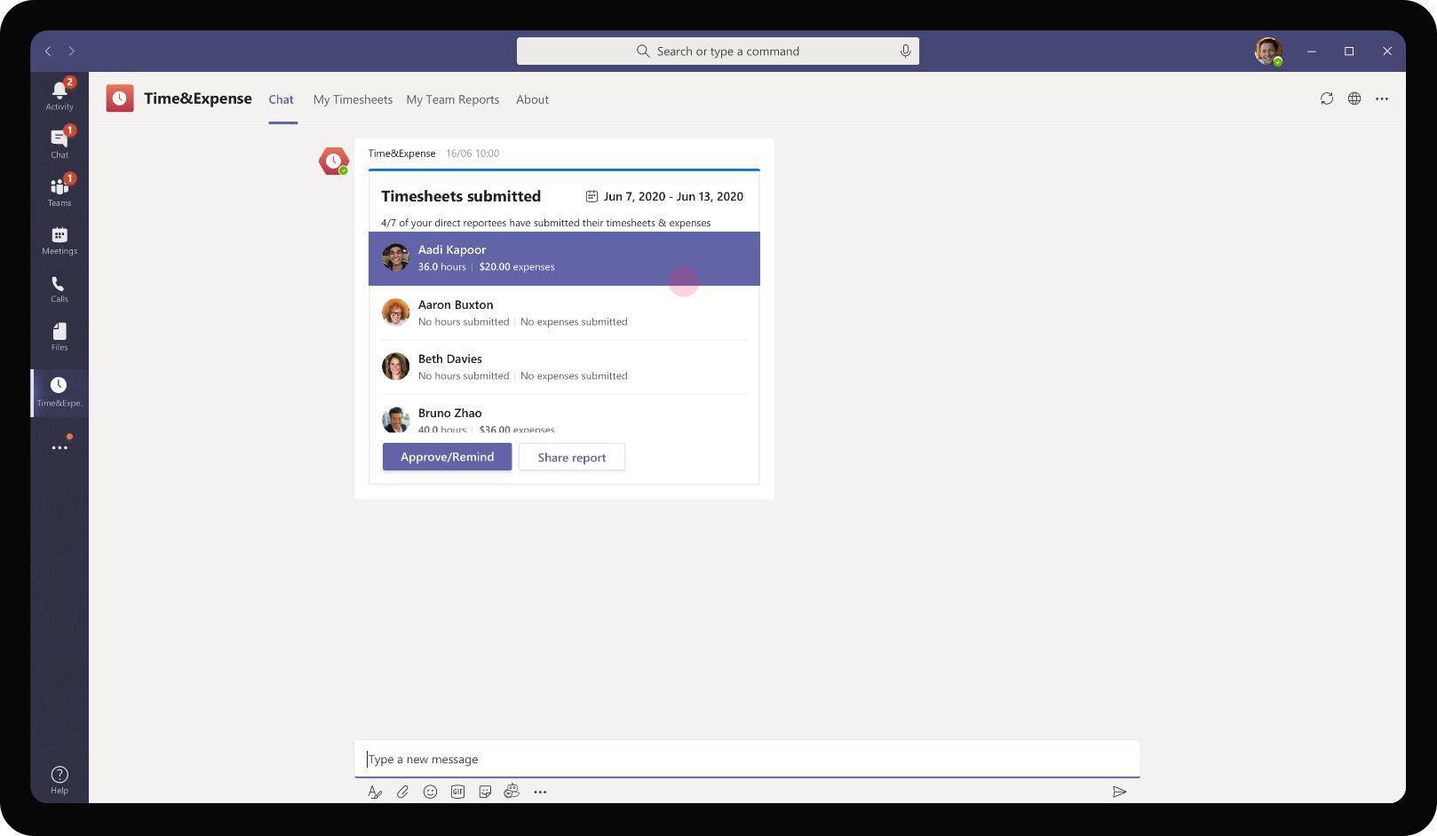
Professional Services – Time & Expense
The app consolidates time & expense submission details across all direct reports of Miguel and provides a summary view for Miguel to take action upon.

Slide 32
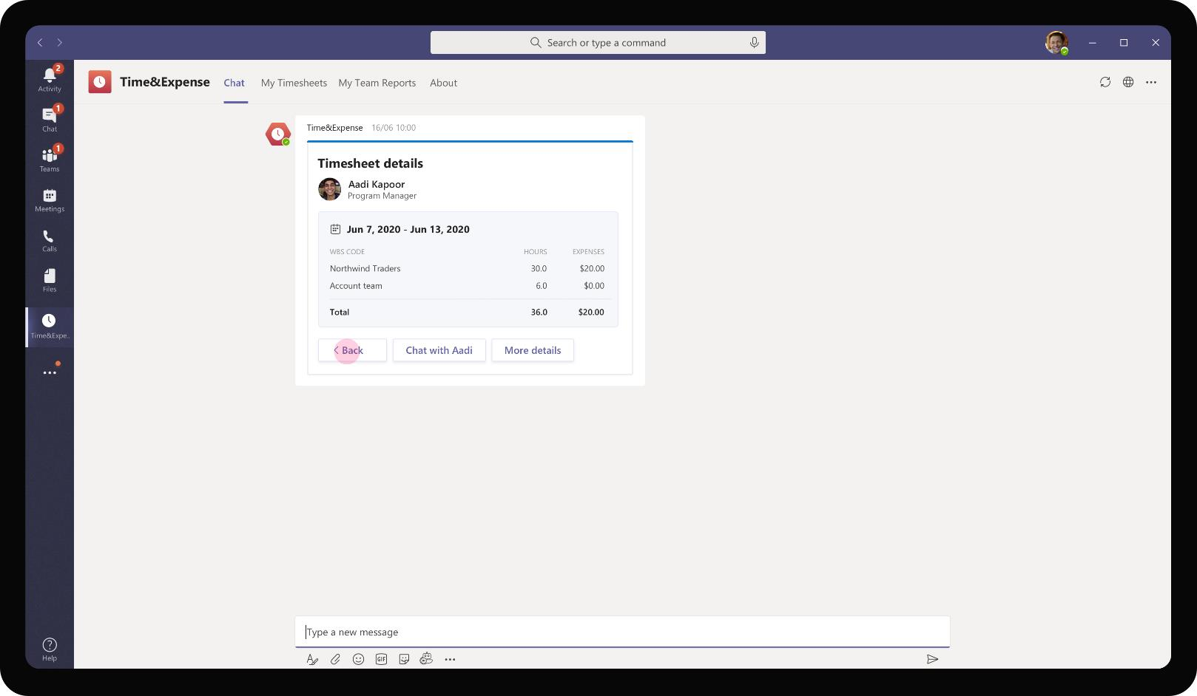
Professional Services – Time & Expense
Miguel has the ability to delve into the details of each submission to see expense and time split for each client. If there are any discrepancies, Miguel can reach out to his team member to have a 1:1 personal chat

Slide 33
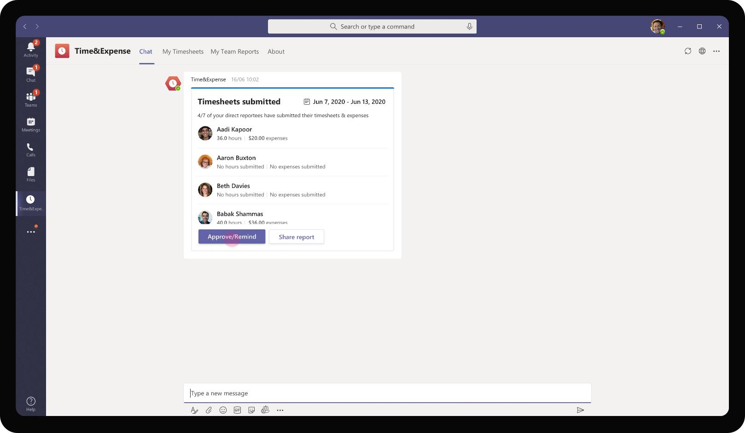
Professional Services – Time & Expense
As Miguel proceeds to approve the time report submission of his reports, he clicks on the bot card button. Alternatively Miguel can share the report within his Team / channels or export it as an excel file

Slide 34
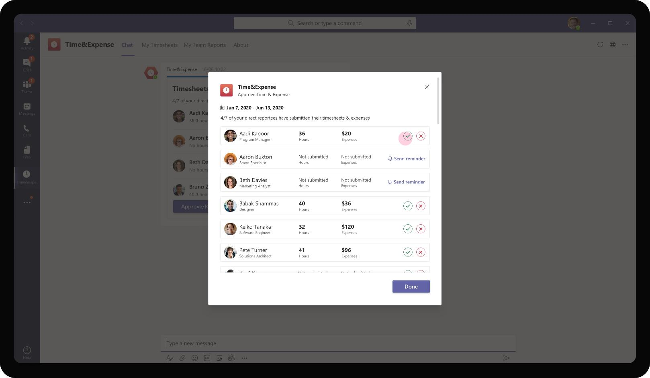
Professional Services – Time & Expense
On clicking Approve / Remind, a task module opens up with summary view of hours submitted and expenses incurred for each team member. For members who have submitted as per compliance policies, Miguel can approve the requests in task module directly.

Slide 35

Professional Services – Time & Expense
Where time or expenses do not seem to follow policy recommendations or if there are erroneous entries, Miguel may choose to reject the submission

Slide 36
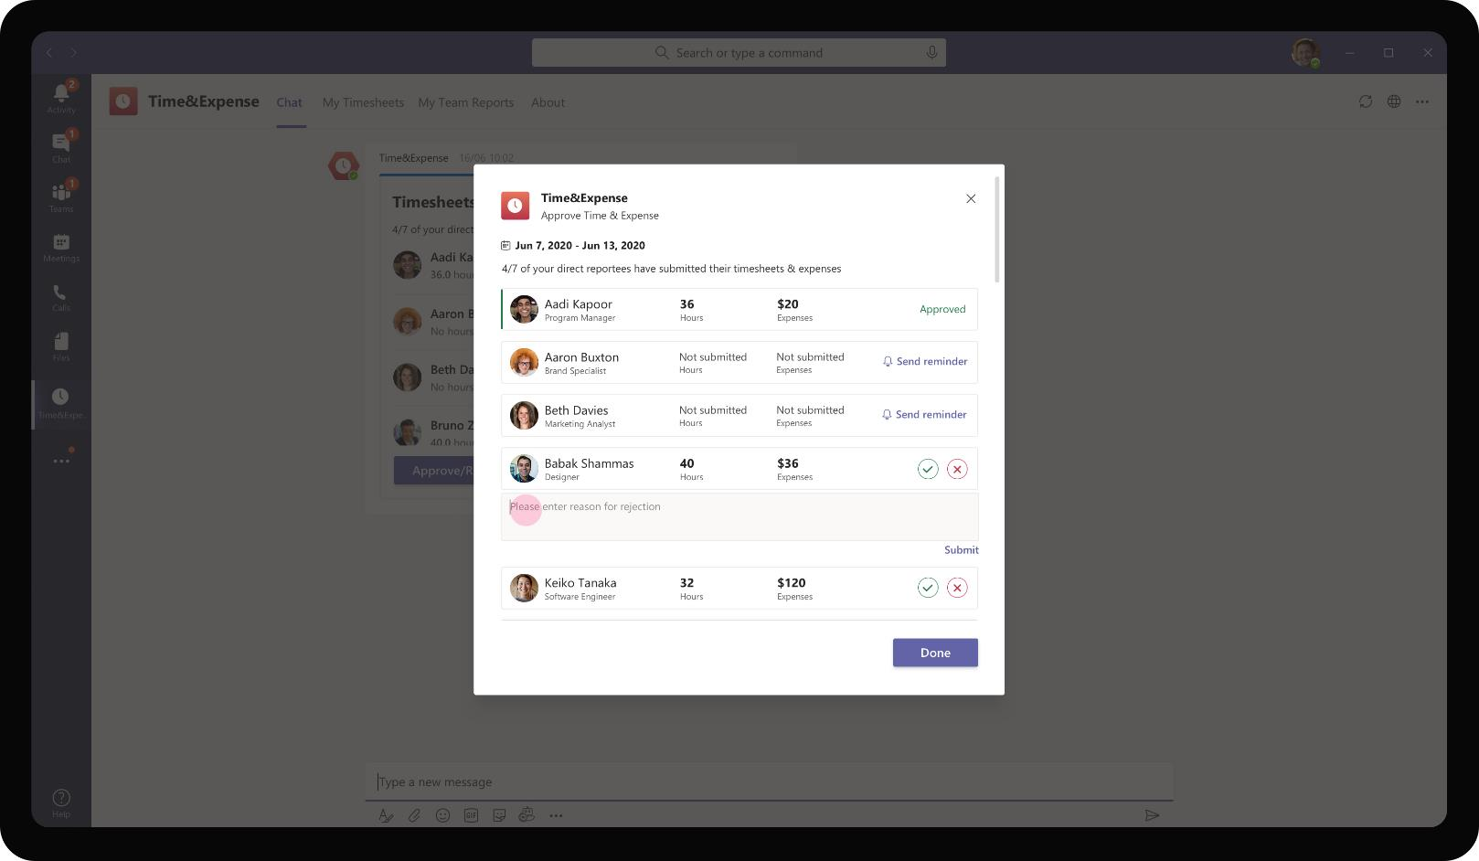
Professional Services – Time & Expense
As Miguel clicks on reject for a time sheet submission, he is prompted to enter a reason for rejection that would be sent to the team member who submitted the time sheet.

Slide 37

Professional Services – Time & Expense
As Miguel clicks on reject for a time sheet submission, he is prompted to enter a reason for rejection that would be sent to the team member who submitted the time sheet.

Slide 38

Professional Services – Time & Expense
Miguel can use the same task module to send reminders for members who haven’t made the time sheet submission. This triggers an adaptive card message for the team members prompting them to enter time sheet reports immediately.

Slide 39

Professional Services – Time & Expense
The adaptive card with summary view of time sheet submissions for the week gets refreshed to show the actions that Miguel had taken for individual submissions.

Slide 40
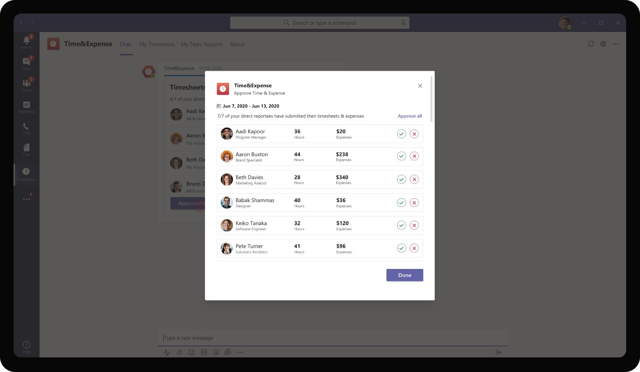
Professional Services – Time & Expense
If all team members have submitted their time sheet reports promptly, Miguel can approve all requests in one click using the Approve All button

Slide 41
Solution Highlights – Best Practices
Professional Services – Time & Expense
Key Solution Design Considerations
Platform Extension Points
User Experience
Personal Scoped App The app is completely personal scoped because Time submission, expense items are personal and confidential information and not required to be handled in a Team context
Personal Tab – There are two personal tabs to check the status of submitted time sheets and view time sheets of your direct reports. Since this information has visual element to it along with possible analytics it is presented in a canvas view
Personal Bot – A personal scope bot handles the approval workflow, submission workflow and recognizes the role of the user to surface right cards
Task Modules are used extensively to gather user input on time submission, expense submission and approvals as it provides greater control over UI constructs and enables user to perform intermediate steps without switching context.
The app uses Adaptive cards for displaying persistent messages only and not intermediary steps. E.g. Time submission is an end goal represented as Adaptive card whereas intermediary steps of choosing WBS, entering hours are performed via Task modules
Card refreshes are used to update the card status instead of sending multiple different cards about the same request. This ensures that readability is easier, and app does not spam with multiple cards for updates.
List cards are used for providing a single consolidated view of time submission reports from multiple team members. This is ideal in this case as individual notifications and cards are cumbersome to track each week. It might also slip out of view as more messages come in.
Proactive Messages are sent at scheduled time every week to remind users to fill in their time sheets.
Graph API
The app also utilizes List DirectReports Graph API to retrieve list of direct reports for all manager role users

Slide 42






Solution Architecture
Professional Services – Time & Expense
Azure Subscription
AAD
External Systems
SSO and Reporting org
Bot / Task Module / ME
T&E Submission & Retrieval Forms
POST Approved reports
Time & Expense Audit Logs
Employee
MS Teams
Bot Registration
Time & Expense
App Service
GET Timesheet reports, Expense Items
GET WBS Codes & Project details
Client Projects WBS Database
T&E Database

Slide 43
Project Finder – Discover internal org wide projects easily
Professional Services Book of Dreams

Slide 44

Scenario Vision
Employee
Context
Daniela, a manager at Contoso Consulting Services is responsible for sales and execution of consulting projects. Most of her projects are 3 – 6 months in duration and she gets a chance to work with different people across the firm in each of her projects
Daniela recently sold a proposal to her retail client and is about to kickstart a project. She just bid adieu to her old team and is eagerly looking forward to putting together a strong team to start her new project.
Current State
Daniela updates information about the project in a mail or Power Point deck. She forwards it to the staffing lead.
The staffing lead maintains a roster of employees' availability. Staffing lead forwards the project information to all available employees looking for projects over e-mail
Employees receive multiple e-mails on various open project opportunities and roles irrespective of their skillsets. They read through all of them and shortlist the ones they are interested in.
Interested employees reach out to Daniela with their resume attached in e-mail.
Daniela receives all applications over e-mail, and she sets up a call with the applicants that match her skillset needs
After discussing with the applicants, Daniela either approves or rejects the applicant for the project. She conveys this decision over e-mail.
After selecting the full team for her project, Daniela sends a mail to the Staffing lead again mentioning that her project open roles are now closed.
Staffing lead sends a mass e-mail to all previous recipients that the respective project is closed for applications
Future State
Daniela uses Teams app to create a new project entity and provides details about her project, duration, required skills and open positions
As Daniela publishes the project entity, it is available for everyone in the organization to view and apply
Employees can filter projects based on their skills and preferences and apply for projects that interests them
As employees apply for Daniela’s project, she gets a notification on her Teams app with employees' application info and attached resume
Daniela views applications and can perform a 1:1 chat / call with each applicant for further clarification
Daniela approves the application on the Teams app itself and the newly selected team member automatically gets added to the project Team setup by Daniela
After Daniela puts together her new team, she closes the project for applications. The project is automatically removed and won’t show up for employees to discover
- Points of Friction

Slide 45

Daniela Mandera, Consulting Manager
Daniela is a manager at Contoso Consulting Services. She is involved in pre-sales, proposal work and frequently does project pitches to her clients. She also handles putting together a team for her sold project opportunities and executing the project to success

Slide 46
Daniela recently won a project opportunity with a Retail client and is looking to put together a great team at different roles for project execution

Slide 47
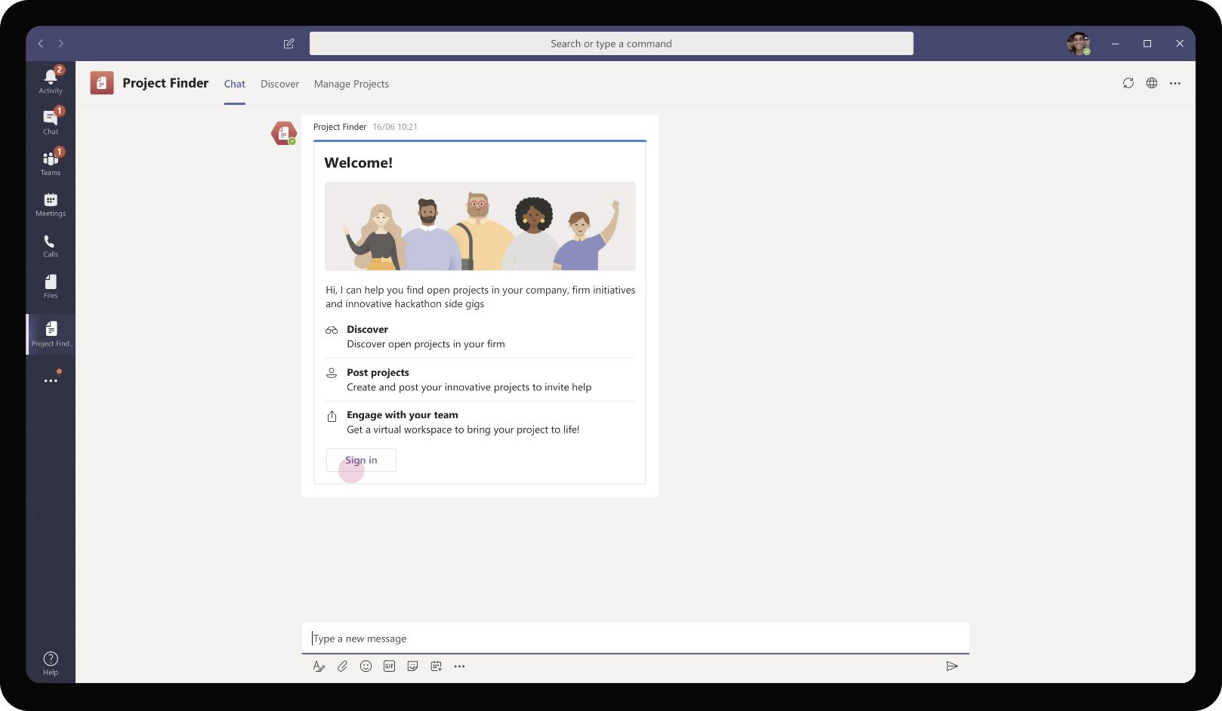
Professional Services – Project Finder
On adding the app, the Project Finder bot sends a welcome card with the various actions that a user can perform using the app. Employees using the app would be able to discover new projects, create projects for their specific engagements

Slide 48
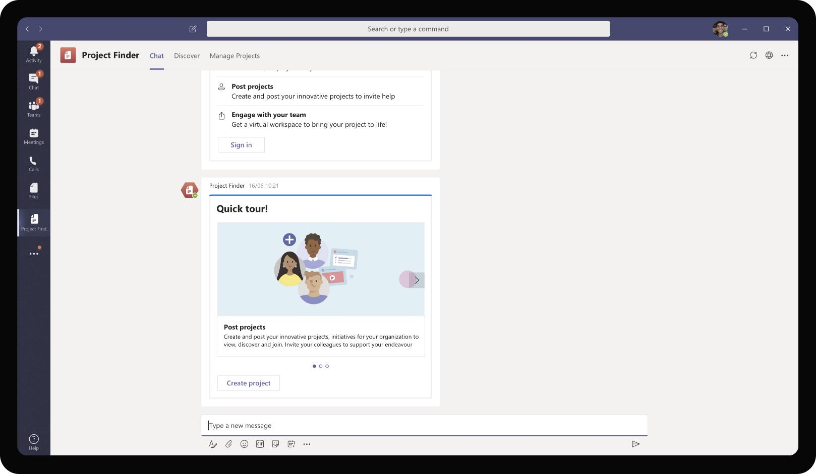
Professional Services – Project Finder
As Daniela is looking to put together a team for her newly sold client opportunity, she chooses to proceed with Create Project option that the bot card presents

Slide 49
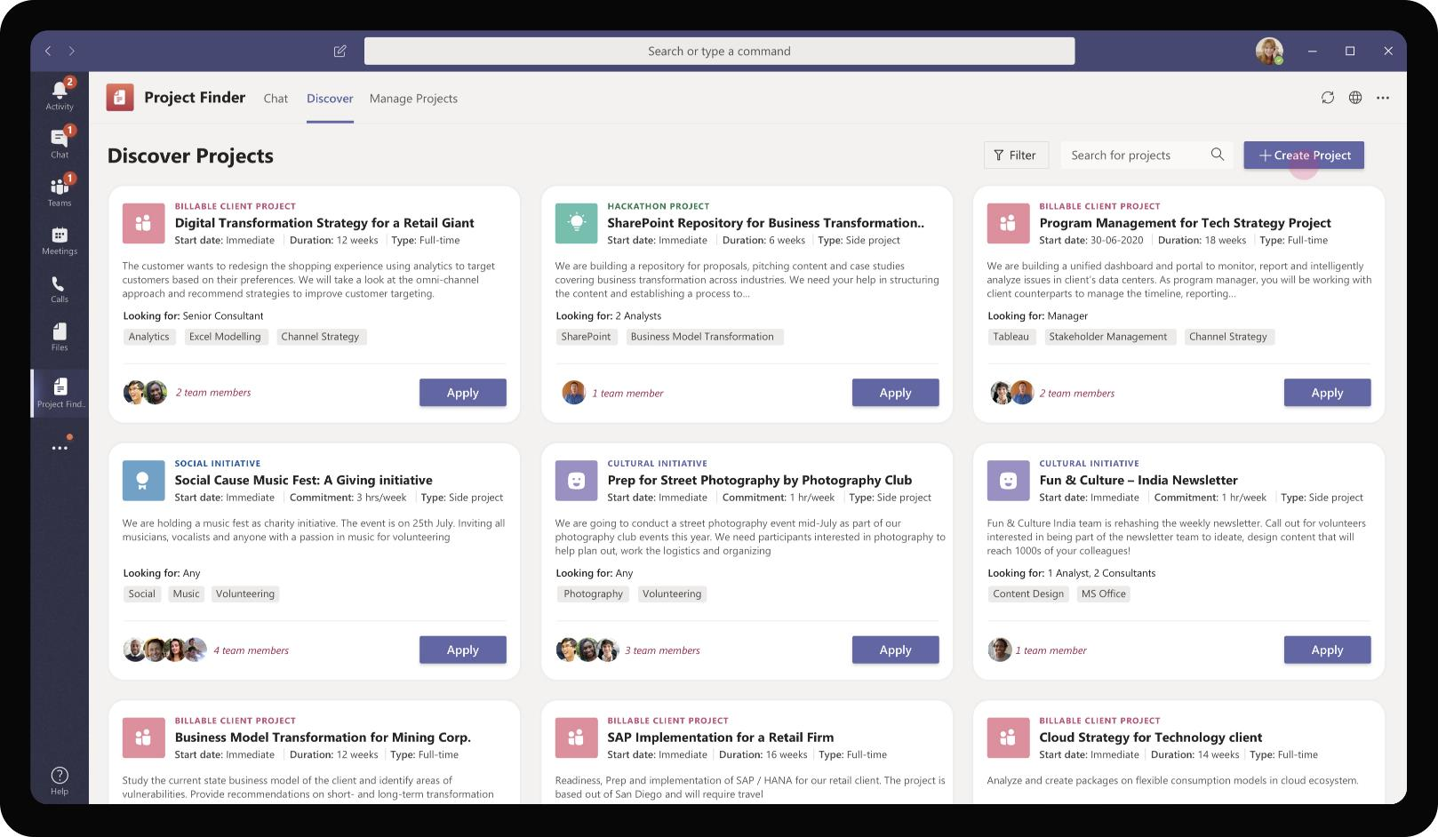
Professional Services – Project Finder
Daniela can also create projects by clicking on the ‘Create Project’ button in the Discover tab. It is placed prominently and is persistent way that Daniela can come back to whenever she has a need to put together a team for a new project opportunity

Slide 50
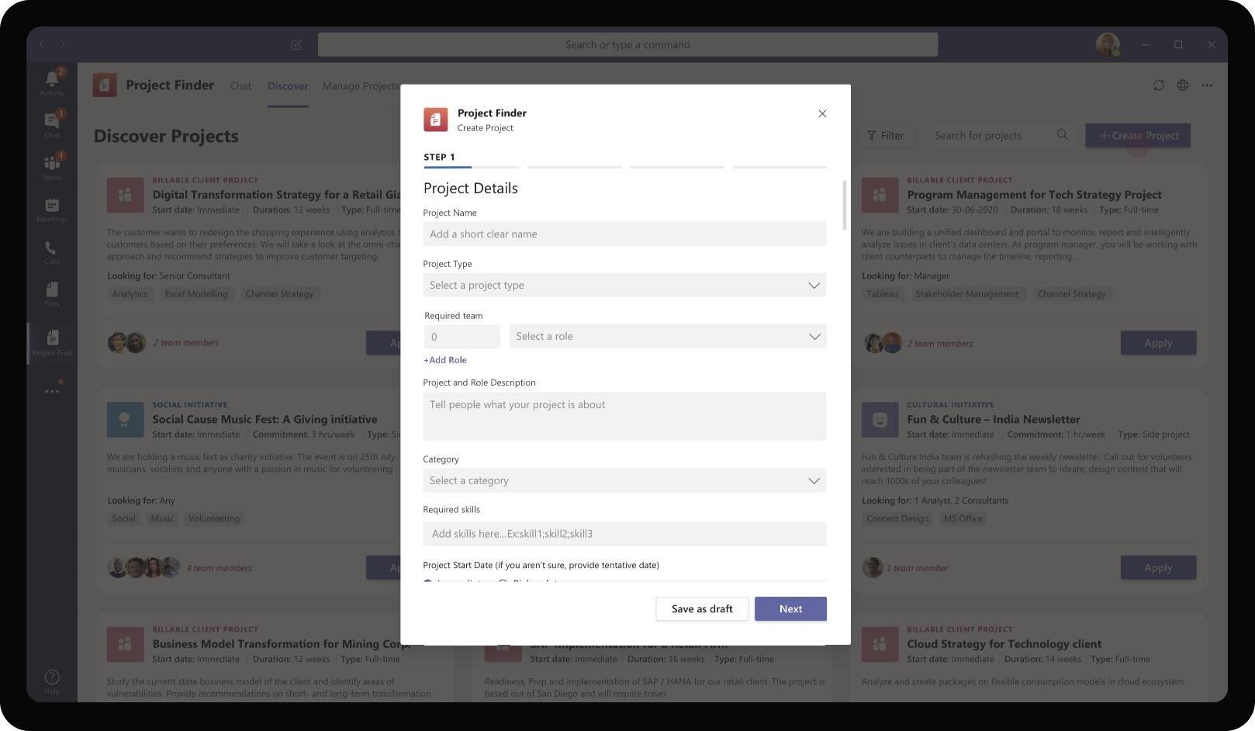
Professional Services – Project Finder
On clicking ‘Create Project’ it opens a task module that gives a list of options in a form view for Daniela to enter details around the project. Daniela has open space to explain about the project, skills required for people to apply and number of open roles in the Team

Slide 51
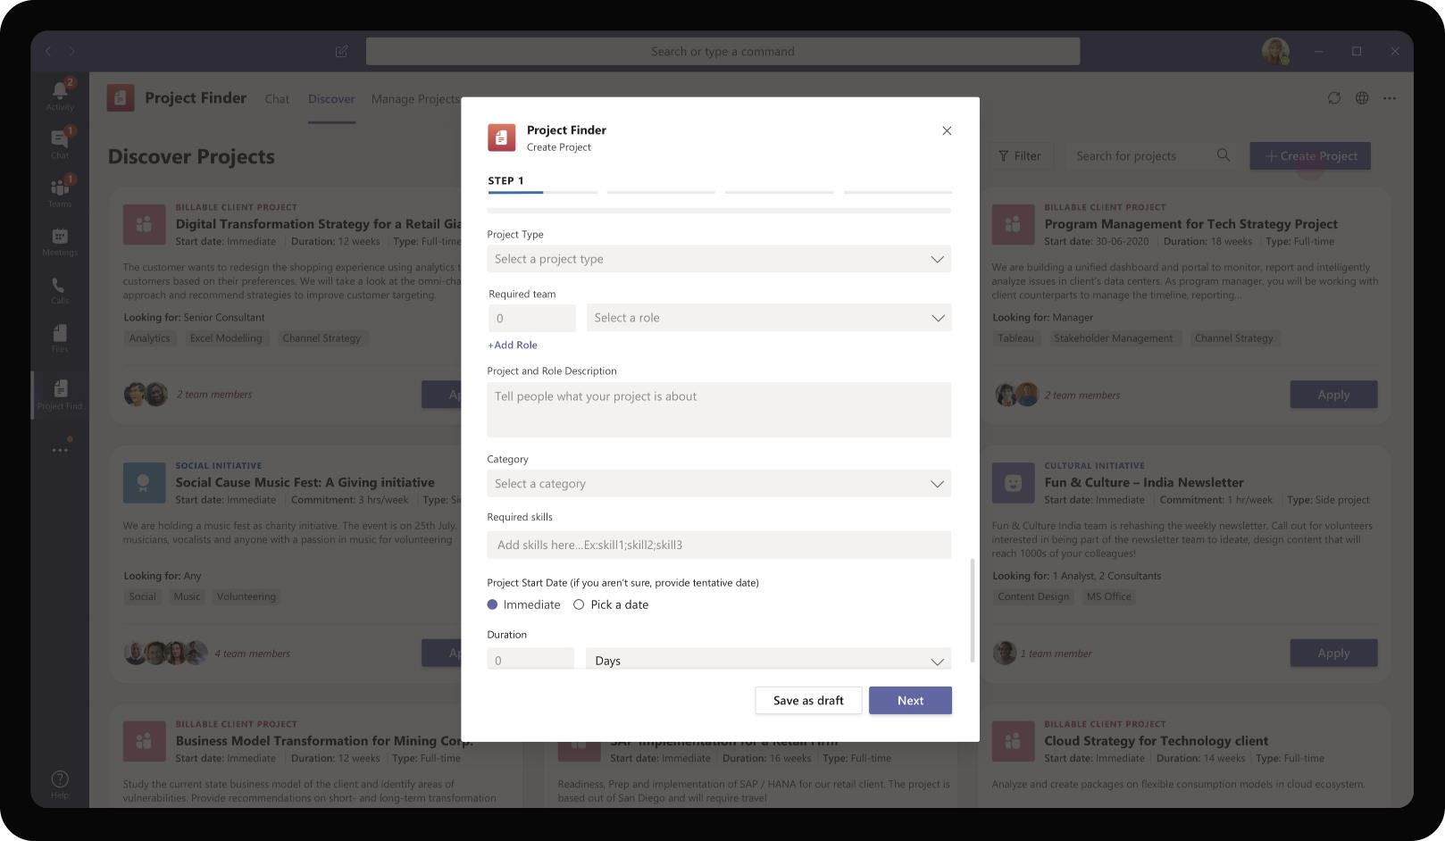
Professional Services – Project Finder
In addition, Daniela can also mention the start date for the project and tentative duration so that applicants can make a decision on their availability before applying for the project

Slide 52
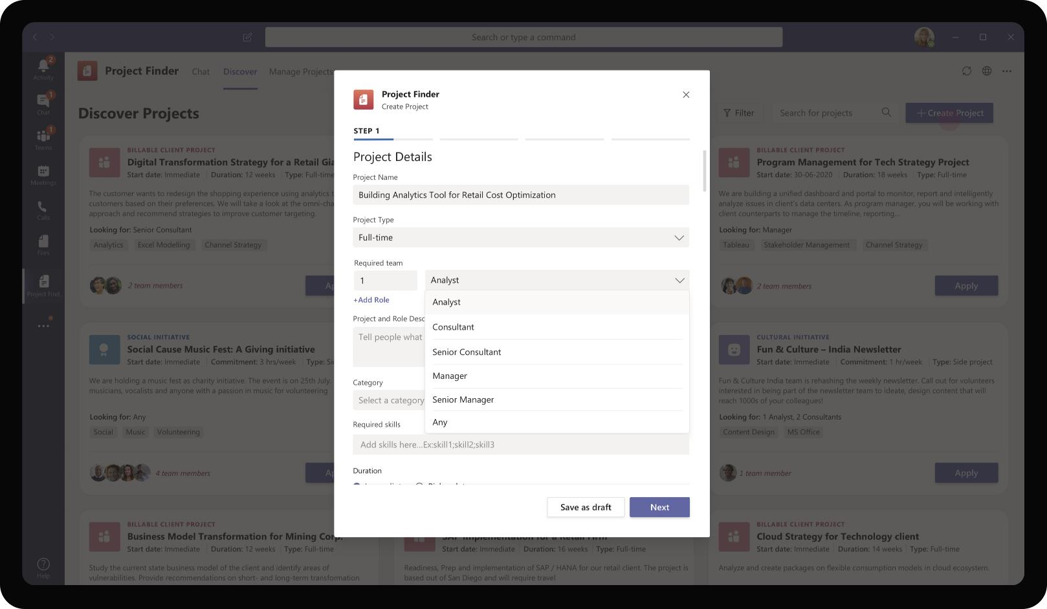
Professional Services – Project Finder
Daniela proceeds to fill in details of the project and mentions whether it is a part time activity or side projects or a full-time project. She also uses mentions the number of people she needs on the Team for each role level

Slide 53
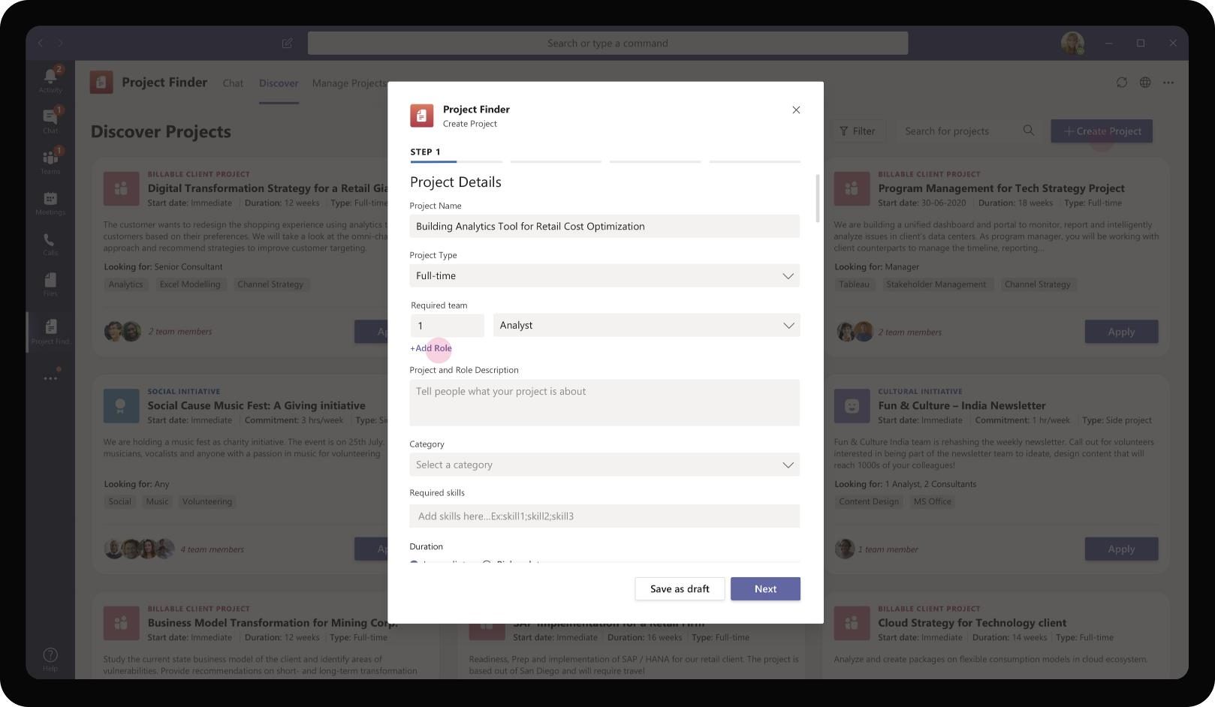
Professional Services – Project Finder
On clicking Add roles, Daniela is able to add more roles to her team mix.

Slide 54
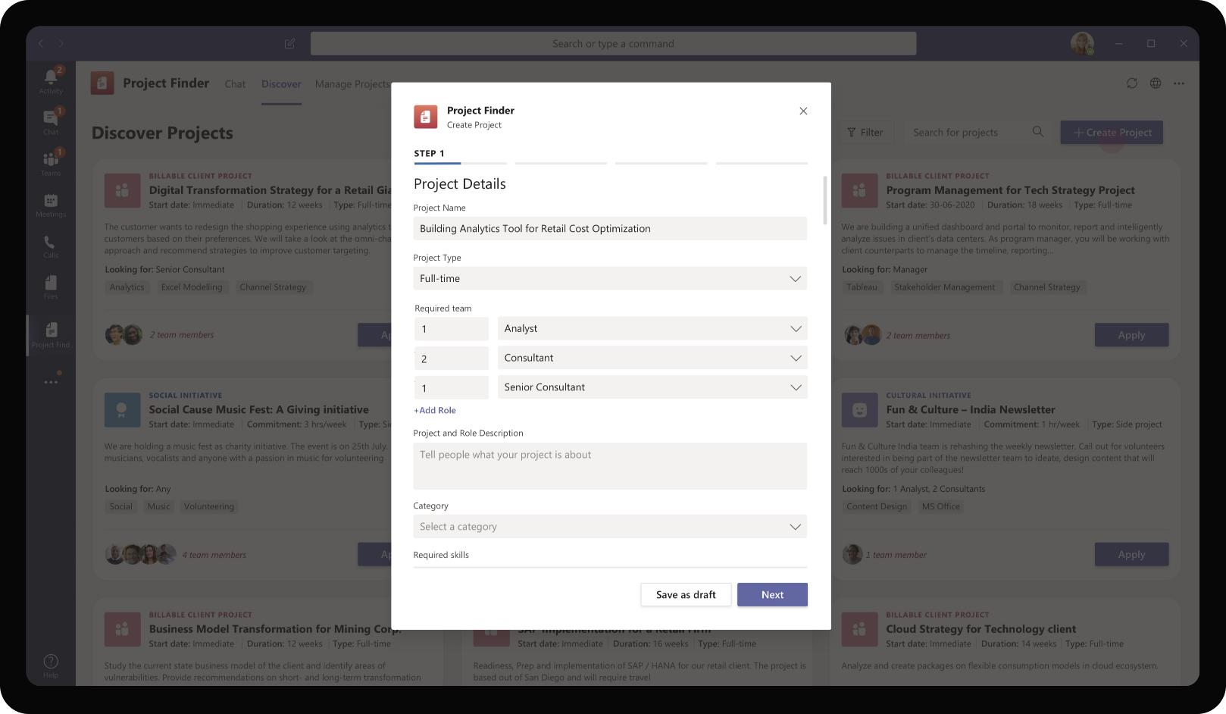
Professional Services – Project Finder
Daniela proceeds to mark the team requirements she has on the form. For each type of role, Daniela marks the number of open roles available at that level so that applicants can apply based on their role fit.

Slide 55
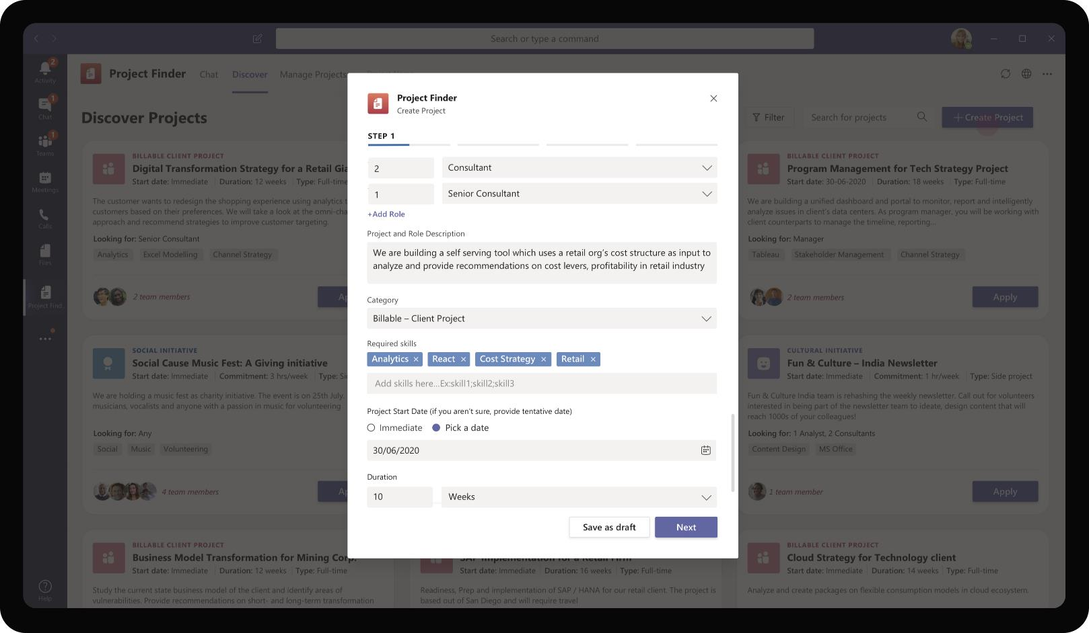
Professional Services – Project Finder
Projects could be client projects that run for 6 months, fun one-time activities like putting together a team to organize an Org level marathon, or side projects that span over months. Daniela chooses client project and provides skills she is looking for and tentative duration

Slide 56
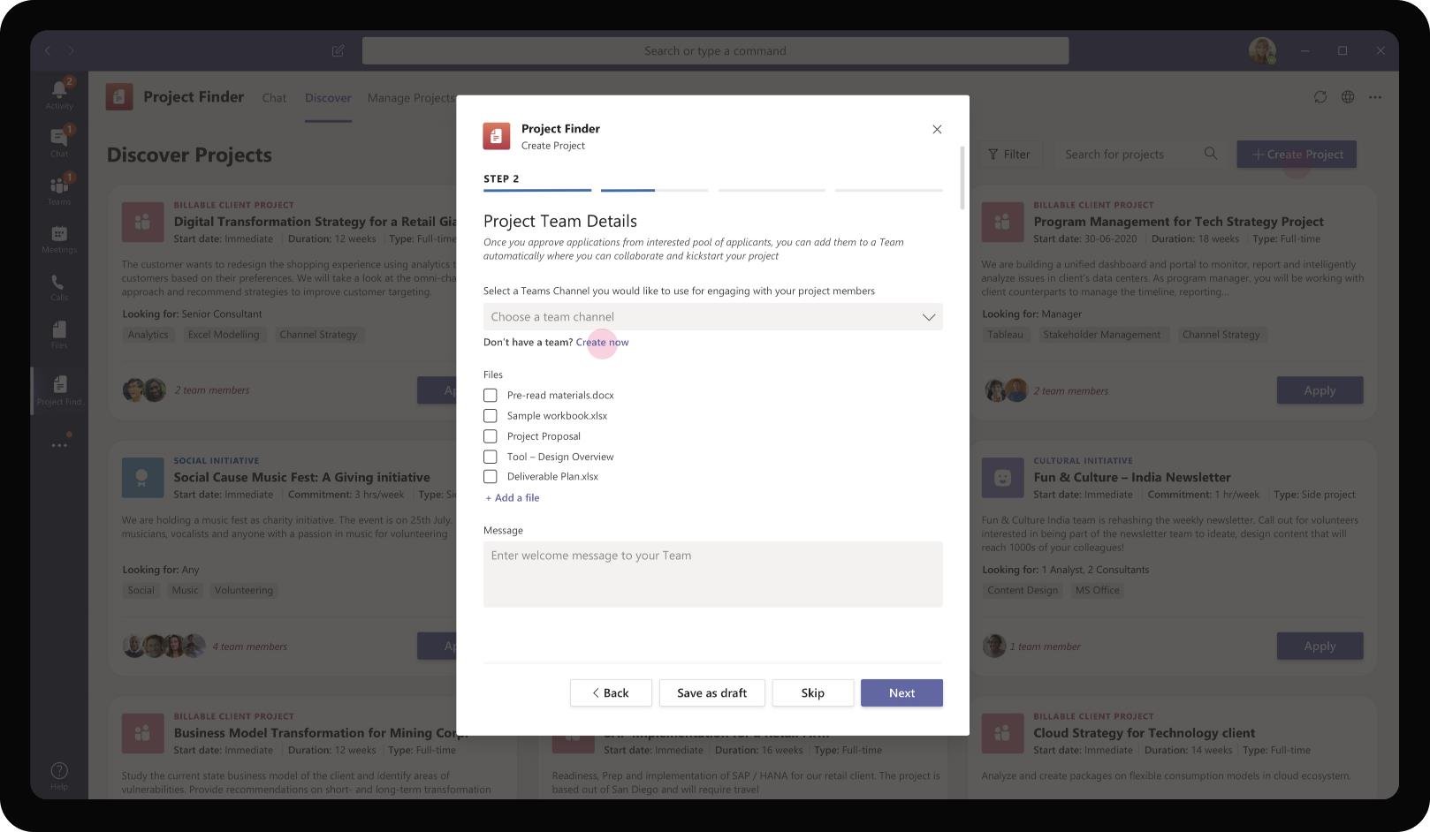
Professional Services – Project Finder
Daniela has an optional step to automatically add the selected team members from the applicant pool in a Team and channel she has created. If she does not have a Team / channel, the app helps Daniela create the team too.

Slide 57
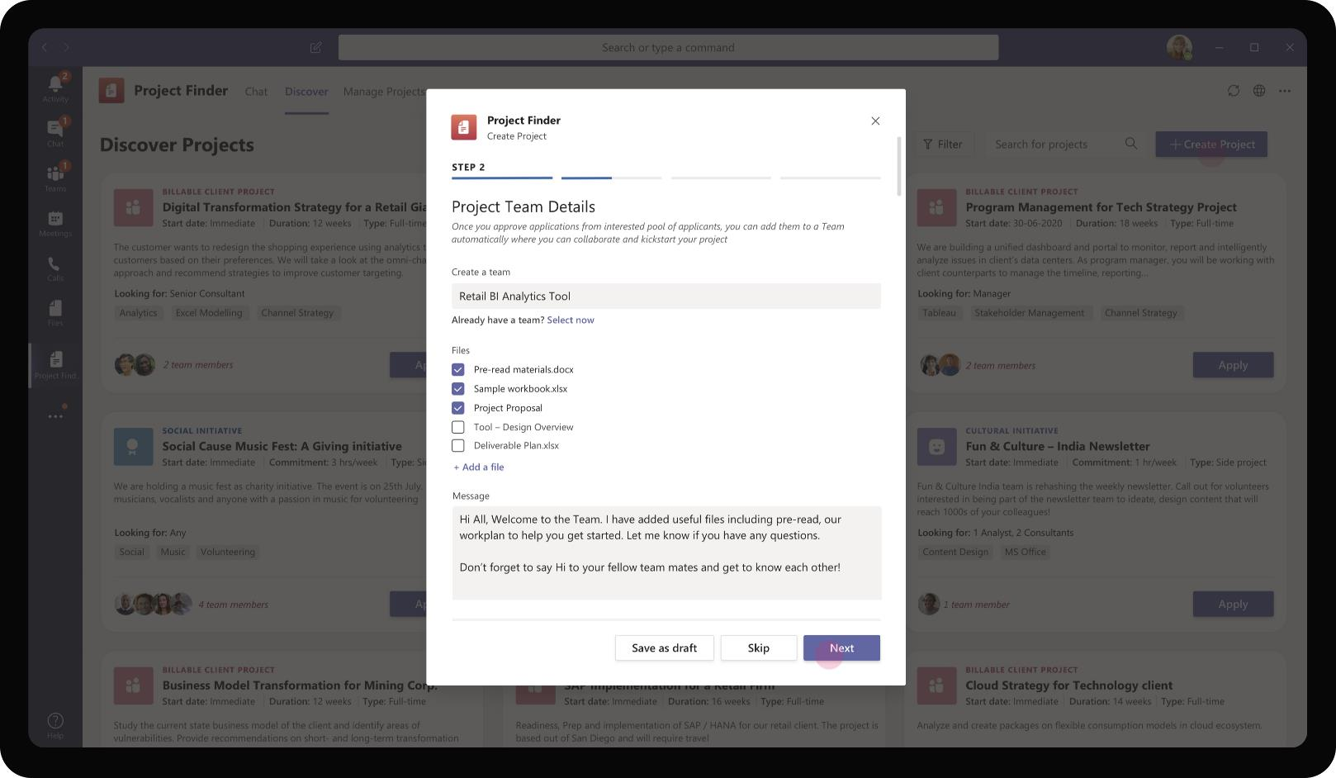
Professional Services – Project Finder
Daniela creates the Team to add selected members. In addition, she adds files from her SharePoint to the Team. The selected files are automatically added to the Files Tab of the newly created Team.

Slide 58
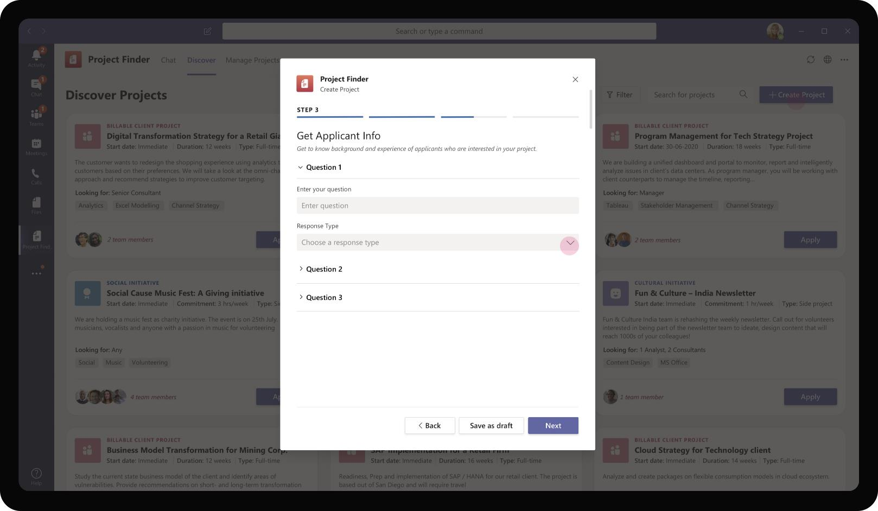
Professional Services – Project Finder
The app also provides an option for Daniela to ask a few simple questions to the applicant who wishes to be part of the Project team. For client projects this could be about their relevant experience in the past whereas for fun activities, this could be purely logistics oriented and confirming time created

Slide 59
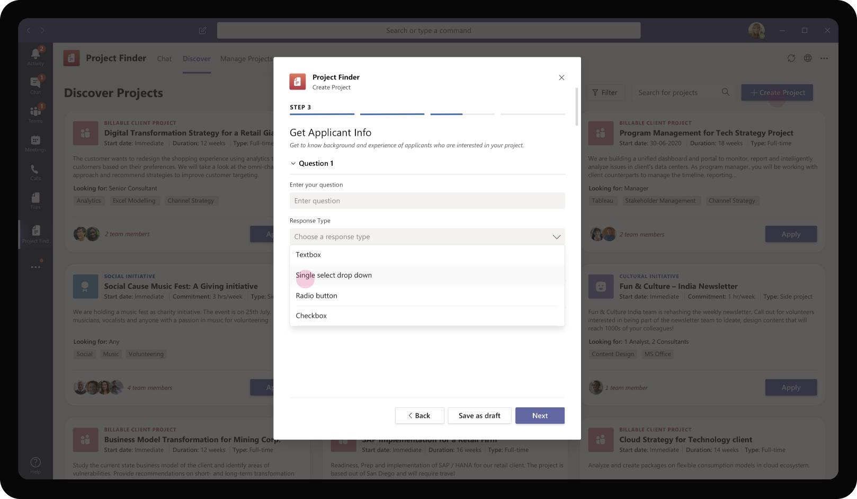
Professional Services – Project Finder
The app provides Daniela option to add questions of different types (drop down, text box, check box) in the Applicant Info form. These few basic types of questionnaire allows Daniela to customize her input form to get relevant details from applicants

Slide 60

Professional Services – Project Finder
Daniela proceeds to add few applicant registration questions that would provide her useful input when she is evaluating the pool of applicants with aim to select a few for the final project team.

Slide 61

Professional Services – Project Finder
On selecting a drop down, Daniela is prompted to add options in the drop down. This would be presented to the applicant as a drop down list of options

Slide 62
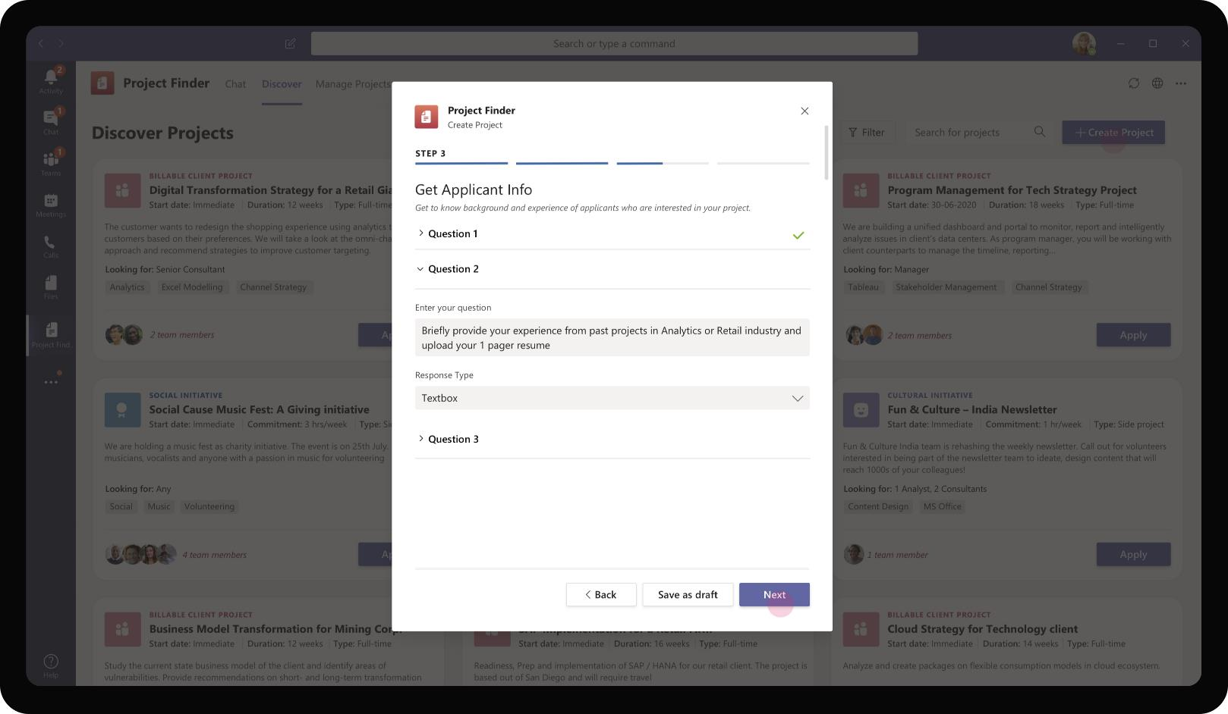
Professional Services – Project Finder
Daniela proceeds to add more questions – a descriptive response from the applicant on his/her past experience in a similar domain. This gives applicants a chance to showcase their experience and skills that will differentiate from others

Slide 63
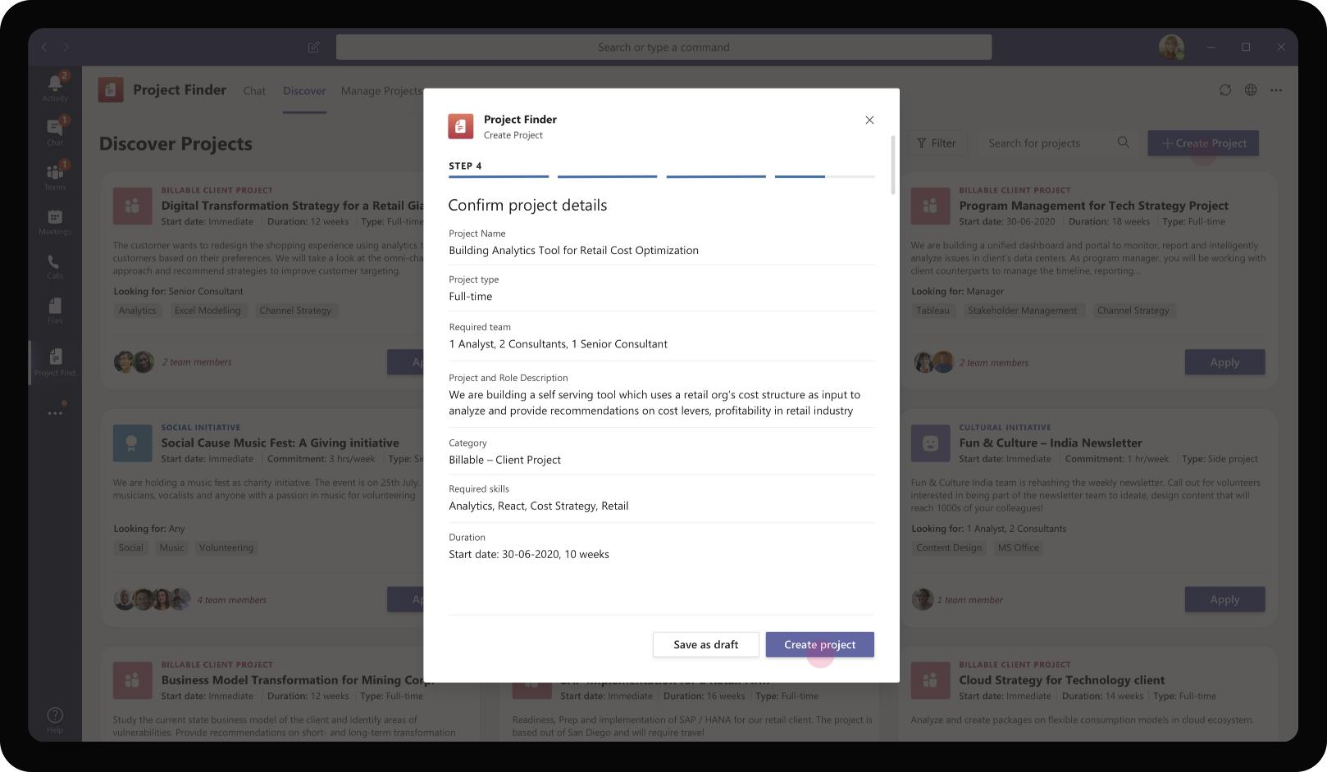
Professional Services – Project Finder
At the final step of project creation, the task module provides a preview of the project with information that Daniela had entered. After validating that the details are accurate, Daniela proceeds to create the project.

Slide 64
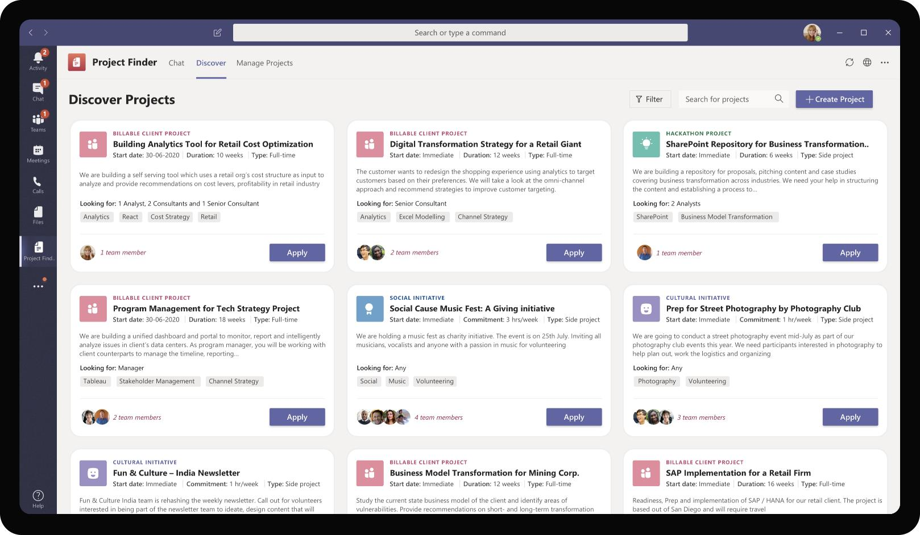
Professional Services – Project Finder
Daniela’s newly created project appears as a tile along with other projects. It highlights the name, start date, role requirements, skills. The tile keeps getting updated dynamically as and when team members get updated. Rest of the organization can find the project and apply for it.

Slide 65

Aadi Kapoor, Senior Consultant at Contoso Consulting
Aadi Kapoor is a newly promoted Senior Consultant at Contoso Consulting Services. He is always on the lookout for new, exciting opportunities, projects in his firm and is constantly looking to grow his skills in Analytics domain

Slide 66
Aadi has recently rolled off a project with a client. He is actively looking for new projects and is interested in joining projects which will augment his proficiency in Analytics domain

Slide 67
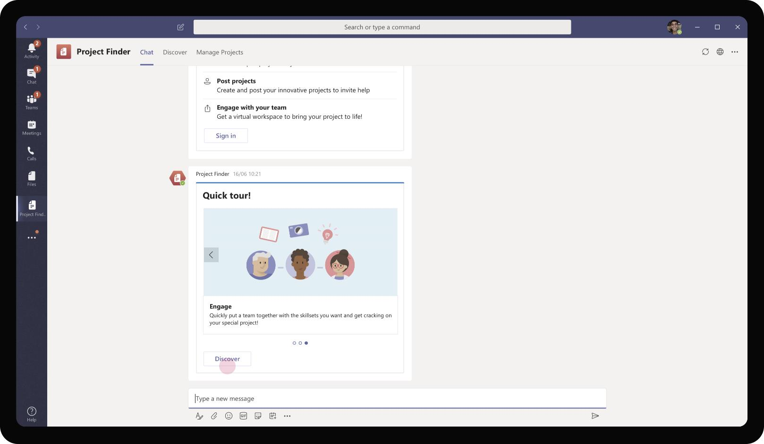
Professional Services – Project Finder
After signing in on the welcome card, Aadi browses through the various capabilities offered by the app. Since Aadi is more interested in finding projects he can be part of, he chooses to click on Discover

Slide 68

Professional Services – Project Finder
Aadi is taken to the Discover tab of the app and is shown a grid view of various projects that are currently looking for talented team members. Aadi can filter by type of projects, skills, start dates and duration. He chooses to apply for the Analytics project posted by Daniela

Slide 69
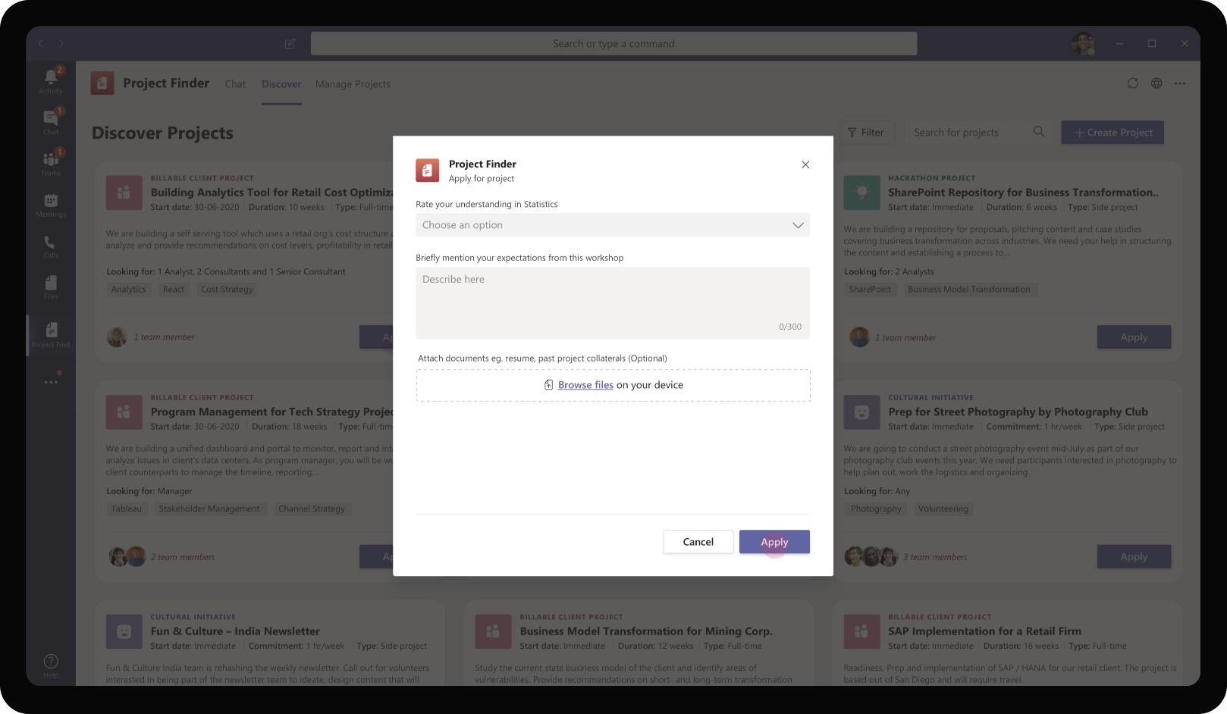
Professional Services – Project Finder
On clicking on Apply, the app opens a task module for Aadi to fill in responses to few questions posted by Daniela.

Slide 70
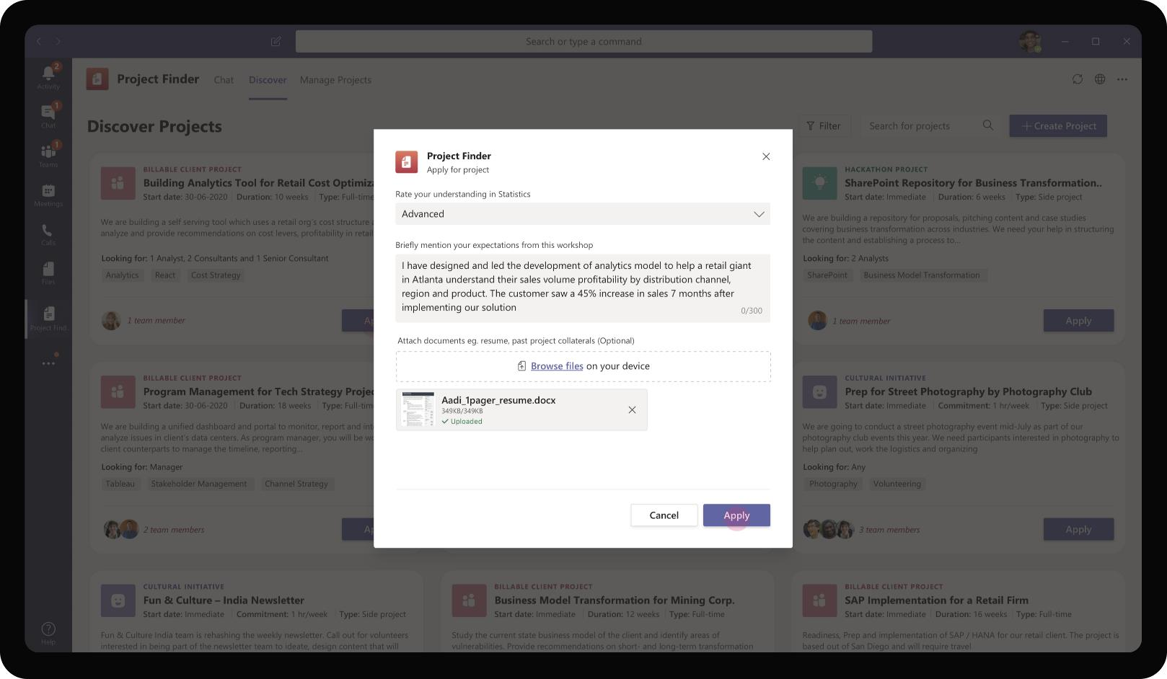
Professional Services – Project Finder
The app also provides a way for Aadi to upload files such as his resume or showcase slides from his prior projects.

Slide 71
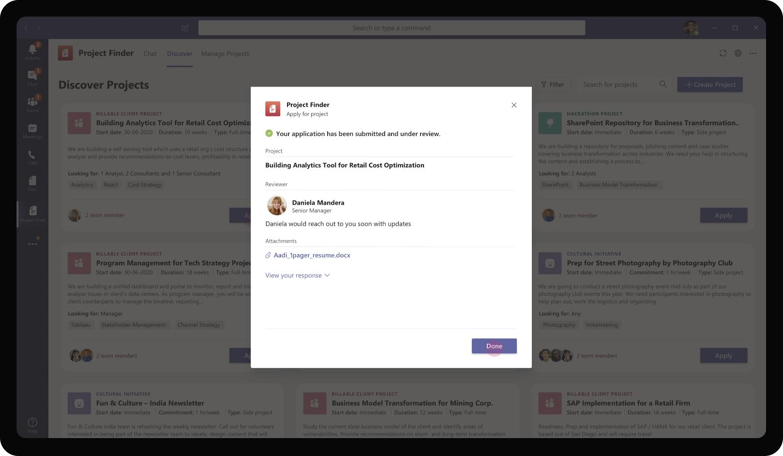
Professional Services – Project Finder
On submission, all this content would be sent for the owner of the project for review. This information is shown to Aadi as well to keep him updated of who will be reaching out to him on next steps.

Slide 72
As various applicants start to apply for the project, the app surfaces applications with useful applicant insights for Daniela to review and make a decision

Slide 73
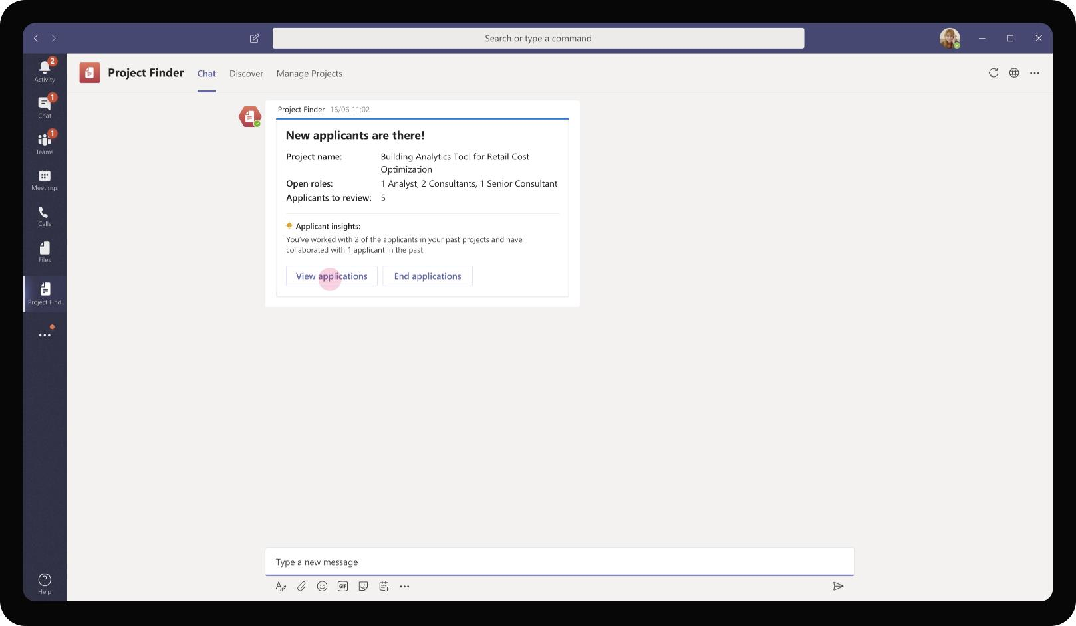
Professional Services – Project Finder
As various applicants start to apply for the project, Daniela receives an adaptive card notifying her of applications available for her review. Daniela can choose to start viewing the individual applications in detail by clicking on the card button – View Applications.

Slide 74
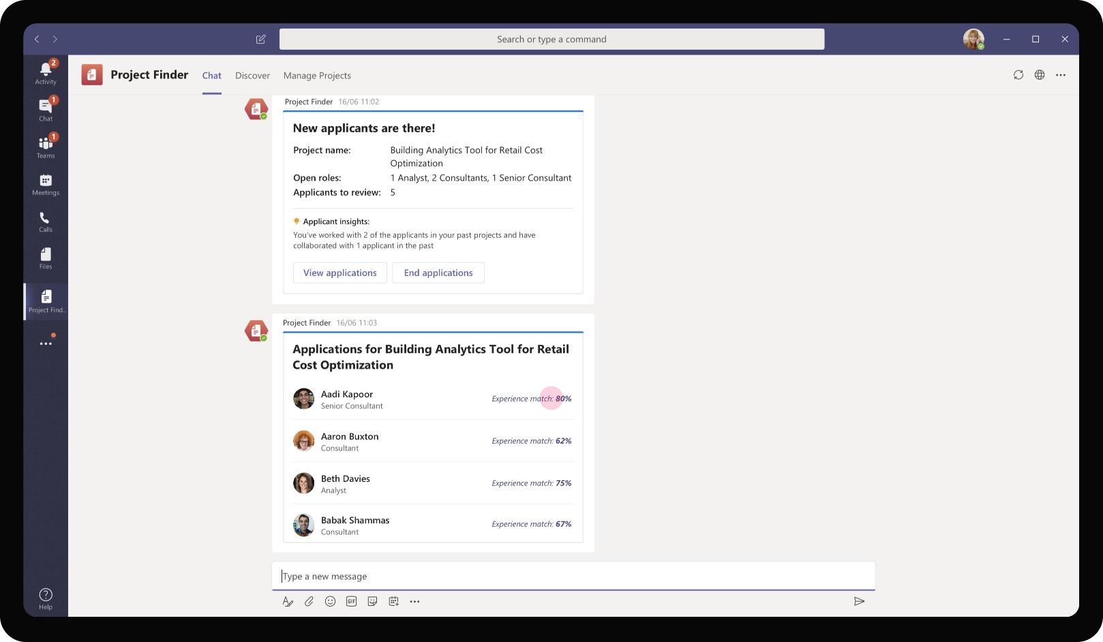
Professional Services – Project Finder
The bot sends a list card with a list of all applicants, their roles and experience match score for each applicant. Since the app knows all prior projects each applicant has been part of, it calculates a score for each applicant based on skill similarity of projects they have worked on so far.

Slide 75
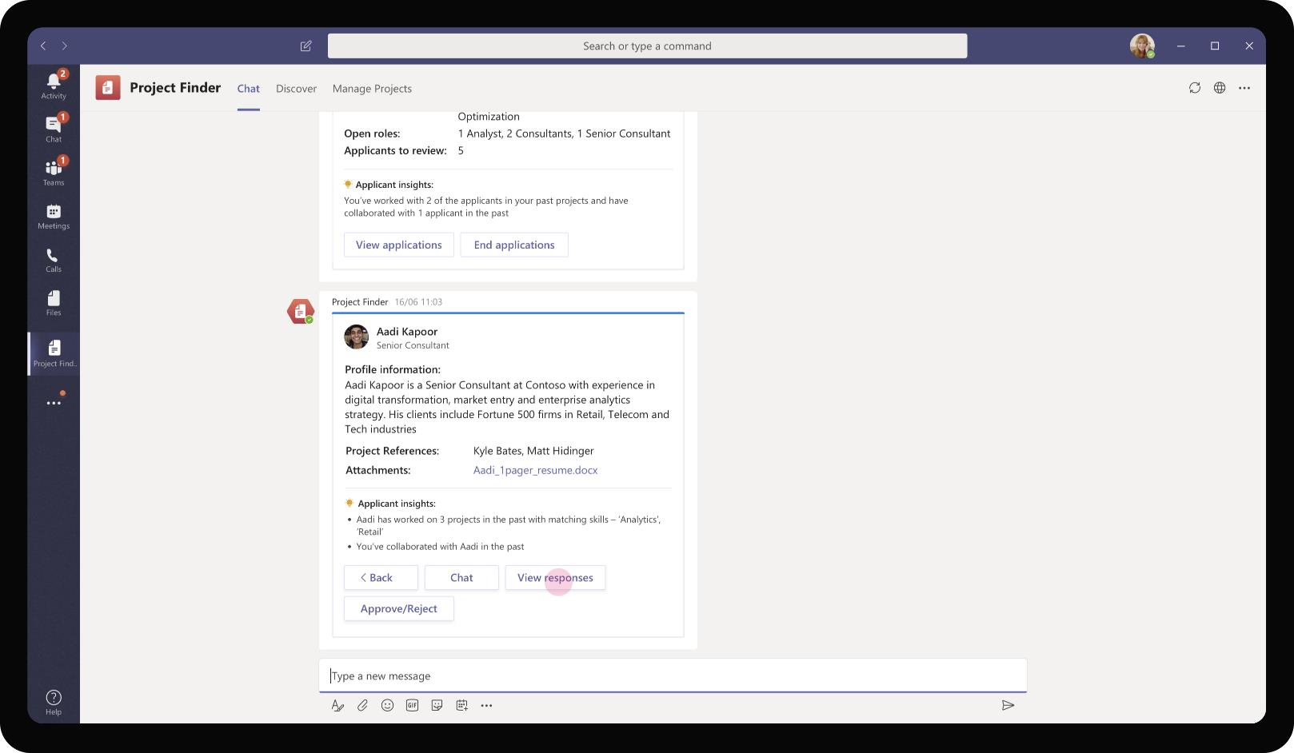
Professional Services – Project Finder
On clicking on each applicant row, the adaptive card refreshes to detailed profile with additional applicant insights. The app calls out matching skills from Aadi’s previous projects and calls out if Aadi and Daniela had worked together in the past (shared files between each other)

Slide 76
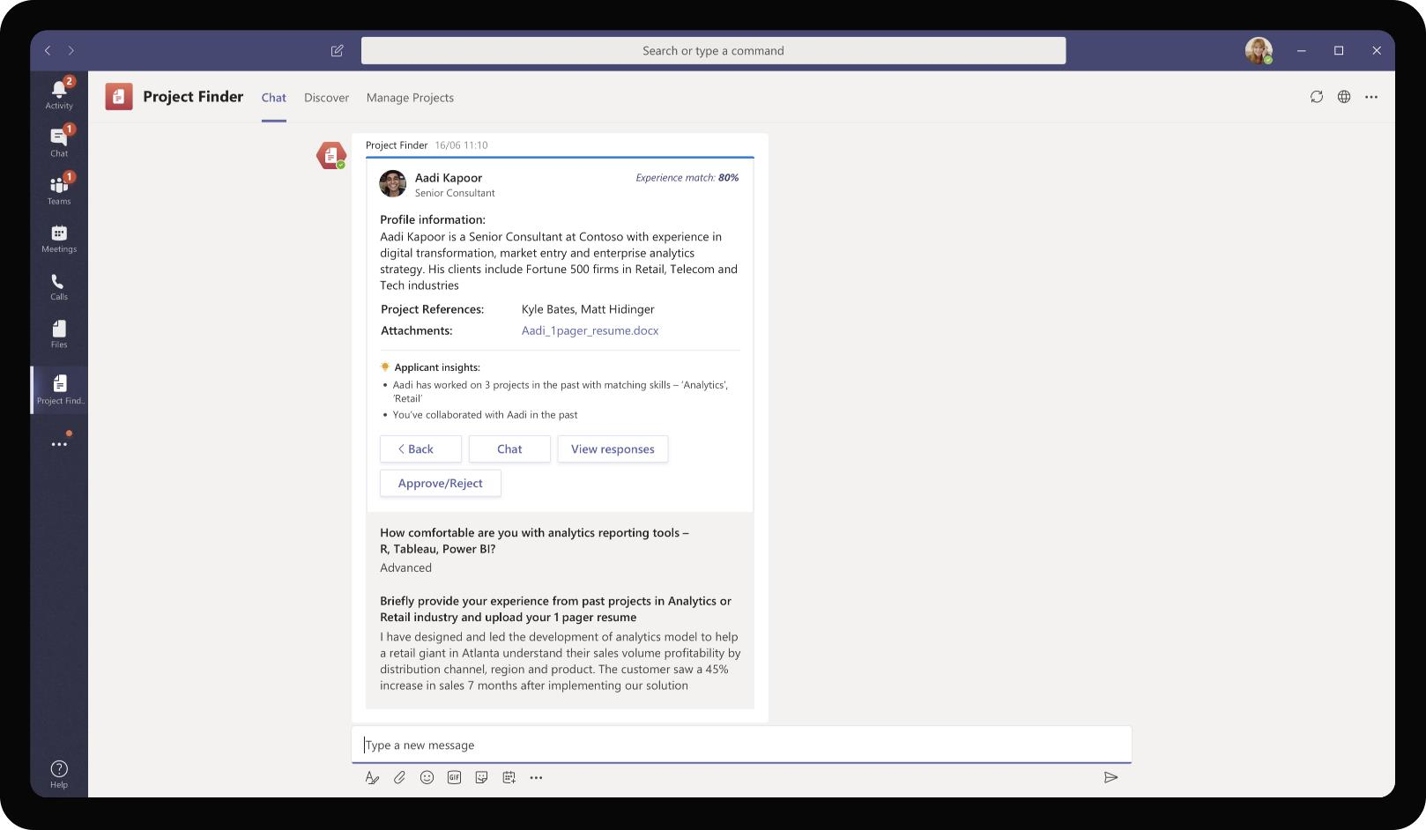
Professional Services – Project Finder
Daniela views Aadi’s responses to the questions she had posed while creating the project. In addition, she has Aadi’s 1 page profile as well to understand his skills and past experience. Further, she can choose to chat with Aadi directly for any clarifications on his profile.

Slide 77

Professional Services – Project Finder
As Daniela clicks on Approve / Reject, she is prompted with option to mark Aadi as approved to be added to the project team. In addition, she can choose the role she wants to consider Aadi for the project. This ensures that the app updates the remaining open roles in the project.

Slide 78

Professional Services – Project Finder
As Daniela approves Aadi to the Team, the adaptive card refreshes back to the list view of applicants and shows Aadi’s line item as Approved. Daniela can proceed to evaluate other applicants for the team.

Slide 79

Professional Services – Project Finder
As applicants are approved, they get automatically added to the Team created by Daniela. Daniela’s welcome note is also posted by the bot for all team members to view. In addition, the Files tab of the General channel will contain the pre-read materials Daniela had added for team to kickoff.

Slide 80
Solution Highlights – Best Practices
Professional Services – Project Finder
Key Solution Design Considerations
Platform Extension Points
User Experience
Personal Scoped App The app is defined to be predominantly personal scoped as project discovery (consume) and posting (produce) are individual activities. The collaboration part of the app brings applicants into one team and encourages dialogue and knowledge sharing
Personal Tab – Both Discover and Manage Projects are available as personal tabs for a user to discover interesting projects based on each employee’s skill set.
Personal Bot – Personal bot caters to each employee’s personal preferences and sends digests of new projects or applicants for posted projects if the user is a project owner
Channel Scope (Optional): Although not represented in the earlier screen, the app has potential to have a channel tab with a config page to choose category / type of projects. E.g. A regional Team can have a channel tab filtered to fun activities, events happening in that region.
Proactive Messages are sent to project owner when a project they had posted receive new applications.
Card refreshes are used to minimize the number of cards sent to the end user and reduce overload on user’s chat window by reducing the number of cards sent for the same project
List cards are used to show applicant names and summary information for each project application. This also serves the purpose of collating all related information (applications to the same project) in one unit as opposed to sending a card with applicant detail for each application.
Graph API
Applicant insights information around collaboration can be retrieved using People & Workplace Intelligence Graph API
The app also uses Graph API to create a Team and to retrieve Files.

Slide 81
Solution Architecture
Professional Services – Project Finder
Azure Subscription
AAD
Graph API
Employee
(Consumer)
SSO and Reporting org
People insights, Files & User profile
Bot / Task Module / ME
Trigger project search, submission, applications
MS Teams
Bot Registration
Project Finder
App Service
GET / POST Project Information
Manager
Applications
Files
Projects Database

Slide 82
Document Management
Professional Services Book of Dreams

Slide 83
Scenario Vision
Employee
Context
Daniela, a manager at Contoso Consulting Services is responsible for creating proposals and pitch decks for initial customer conversations. Her responsibilities include creating pitch decks for her industry customers and winning opportunities for her team
As Daniela is new to the industry and team, she is interested to get a view of the existing assets and materials that Contoso has that she can leverage to get moving fast.
Current State
As Daniela seeks to understand the various assets available pertaining to her industry, she performs a search on the knowledge base available as a portal
Daniela also consults her team members to know any assets they have been using and their favorite resources. She receives names of SMEs to follow up with
Daniela reaches out to various SMEs in her region over chat or meetings and explains her need and background context. The SMEs provide her with the latest assets and resources they generally use
While contributing back to the knowledge base, Daniela works with a content admin team to submit assets for review.
She sends an e-mail to the team with her assets providing useful context around it. The admin team takes time to review.
The team provides feedback on the asset to Daniela over e-mail. Daniela sends a revised version of the asset
Once approved, the admin team uploads the asset to the knowledge base portal and updates Daniela over e-mail.
Future State
Daniela logs in her Teams app to access the knowledge base. She uses the app to search for assets available in the organization
Since the assets are tagged with meta data and categorized in logical groupings, Daniela is able to quickly find materials useful for her industry and type of project
The app takes as input Daniela’s need after a series of questions. Based on her responses, the app intelligently surfaces the latest version of relevant assets that Daniela can use in her customer conversations.
In addition to providing these assets, the app also provides a comprehensive list of SMEs in each domain based on the contributors information that it maintains
Daniela can use the app to submit assets for review by central team. Daniela provides useful context around the asset and submits using the app. Based on the type of content submitted, the app submits it to right team for review
Daniela gets to see real time updates of the content review and approval.
- Points of Friction

Slide 84
Daniela Mandera, Consulting Manager
Daniela is a manager at Contoso Consulting Services. She is involved in pre-sales, proposal work and frequently does project pitches to her clients. She also handles putting together a team for her sold project opportunities and executing the project to success

Slide 85
Daniela is starting on a new cost reduction project with a retail client and is looking to leverage existing assets, models that Contoso has created from similar engagements in the past

Slide 86

Professional Services – Knowledge Helper
As Daniela adds the Teams app, she is welcomed with a message walking her through how the app can help her find information inside the organization and prompts her to start discovering knowledge assets

Slide 87

Professional Services – Knowledge Helper
As Daniela clicks on Start now, the card refreshes to show a guided menu of options to choose from giving a controlled experience into the app’s discovery steps. As Daniela is preparing for customer meeting, she chooses the Find resource option as guided by the app

Slide 88

Professional Services – Knowledge Helper
A task module opens up asking further information from Daniela on the kind of audience she expects to be present during the meeting.

Slide 89

Professional Services – Knowledge Helper
Daniela also mentions the industry in which her customer operates. This will fine tune the search results and surface only assets relevant to the customer’s industry

Slide 90

Professional Services – Knowledge Helper
In order to further make the assets relevant to Daniela’s meeting, the app also asks Daniela to provide input on the type of engagement / topic of discussion in the meeting.

Slide 91

Professional Services – Knowledge Helper
After Daniela inputs parameters about her upcoming customer meeting, she asks the app to search and find resources relevant to her cause. This ensures that Daniela would never have to know the names or types of assets available in the organization. The app takes care of finding the right asset.

Slide 92

Professional Services – Knowledge Helper
Since the app also constantly learns from interactions with other users who search on similar topics, and always knows the updated asset information, Knowledge Helper provides its users access to the right, relevant and latest knowledge information

Slide 93

Professional Services – Knowledge Helper
Daniela clicks on one of the assets sent across as a list. As she clicks, the app sends a detailed card of the specific asset with an option to consume the information right within Teams

Slide 94

Professional Services – Knowledge Helper
As Daniela clicks on Watch video, it opens a task module with the video embedded. In addition, Daniela is able to post comments on the asset and consume comments from others in her organization.

Slide 95
Daniela made use of the assets she found in Knowledge Helper and prepared a successful customer presentation. She wanted to pass on the learnings from her presentation to the asset owner.

Slide 96

Professional Services – Knowledge Helper
For each asset that the app surfaces to end user, it provides an option for users to share their feedback directly with author of these assets. This helps make sure the content is relevant, accurate and is always expanding.

Slide 97

Professional Services – Knowledge Helper
Daniela clicks on Share Feedback option on the asset to submit her feedback. It opens up a simple text box that Daniela can use to enter her learnings from customer meeting.

Slide 98

Professional Services – Knowledge Helper
Daniela suggests that adding relevant case studies to the content would make this asset all the more impactful. Alternatively, Daniela could also contact the author directly (1:1 chat) to discuss any queries or clarifications and provide feedback.

Slide 99

Professional Services – Knowledge Helper
As Daniela submits her feedback, the card refreshes to acknowledge the submission. The author of the asset gets notification and he/she can act on the feedback

Slide 100
After a few weeks, Daniela feels comfortable in her domain and understands the various assets / resources that the organization has to offer. From a consumer, Daniela wants to become an active contributor to the knowledge base as she starts creating great pitching assets

Slide 101

Professional Services – Knowledge Helper
The app also presents the user with a Messaging extension that users can use to search for assets, share it in their Teams, 1:1 or group chats. In addition, the messaging extension also allows user to submit new assets to the knowledge base.

Slide 102

Professional Services – Knowledge Helper
On clicking ‘+’ in the messaging extension, a task module opens up with a form for Daniela to fill. This contains information and metadata for the asset she intends to submit.

Slide 103

Professional Services – Knowledge Helper
Daniela fills in the title and brief description of the asset she wants to socialize with her organization. She also mentions useful metadata that will enable users to accurately search and find this resource. After uploading the asset file, Daniela clicks on Submit.

Slide 104

Professional Services – Knowledge Helper
The asset gets submitted for review by a central knowledge base management authority. Daniela gets an acknowledgement that her asset is awaiting review and she has the option to edit or cancel her submission.

Slide 105

Professional Services – Knowledge Helper
During the review process, any queries or feedback from the reviewing authority gets sent to Daniela directly via the personal bot. Daniela chooses to edit her asset and resubmit

Slide 106

Professional Services – Knowledge Helper
After review is complete, the asset gets uploaded to the knowledge base successfully. Daniela is kept in the loop in all stages of this process with real-time updates on progress

Slide 107
Solution Highlights – Best Practices
Professional Services – Knowledge Helper
Key Solution Design Considerations
Platform Extension Points
User Experience
Personal Scoped App: The app is designed to be a personal scoped app (with personal tab and personal bot) because the information consumption experience is personal in nature. Individuals would search for various assets and consume it for their individual customization and use. Therefore personal scope fits the solution
Messaging Extension: Messaging extensions are used to enable collaboration experiences. It is useful in cases where a user wants to share a useful asset with their colleague or in their Team/channel for all members to view and consume.
Proactive Messages are sent for welcoming users and to send updates about new resources added to the library.
Card refreshes are used to minimize the number of cards sent to the end user and reduce overload on user’s chat window by reducing the number of cards sent for the same content to be reviewed.
Messaging extension has tabs to segregate the type of resource. This enables ease of search minimizing the number of user clicks.
List cards are used to show results of resource search. This serves the purpose of collating all related information (resources pertaining to a single topic) in one unit as opposed to sending a separate card for each matching resource.
Chat deep links are used to create 1:1 chat with author of an asset.

Slide 108
Solution Architecture
Professional Services – Knowledge Helper
Azure Subscription
AAD
Employee
(Consumer)
SSO
Bot / Task Module / ME
Trigger asset search, submission,
GET / POST Assets
Bot Registration
Knowledge Helper
App Service
SharePoint Document library
MS Teams
GET / POST File blobs, conversation IDs
Employee
(Contributor)
Conversations
Files
SME Database

